Slide 1
April Safety Focus: Biological Registration Process
DOHS SOSB
April 2023
Notes:
Audience: ACUC

Slide 2
Administrative Controls
ALL work with biological materials, toxins and recombinant DNA must be registered using PI Dashboard
  https://policymanual.nih.gov/3035
The NIH Biorisk Management Program ensures compliance
NIH Guidelines for Research Involving Recombinant and Synthetic Nucleic Acids
  Information: https://osp.od.nih.gov/policies/biosafety-and-biosecurity-policy#tab2/
  Download: https://osp.od.nih.gov/wp-content/uploads/NIH_Guidelines.pdf
Notes:
Administrative controls encompasses registration documents and surveillance programs. It is now a requirement that all staff sign off on documents.
Lab workers verify they understand the hazards of the material with which they work
Hyperlink Guidelines

Slide 3
Administrative Controls
All Principal Investigators (PIs) must register the following work with the NIH Institutional Biosafety Committee (IBC)
  Creating, manipulating or using recombinant or synthetic nucleic acid molecules covered under the NIH Guidelines (incl. transfected/transduced cells of any type)
  Involving agents infectious to humans, animals, and/or plants
  Involving human and non-human primate blood, body fluids, tissues (primary and established)
  Other potentially infectious biological material
Notes:
“cells” can be murine, human, non-human primate, etc. even if non-infectious

Slide 4
Work with Toxins and Select Toxins
For Select Agent/Toxin Associated Registrations:
Contact the NIH Biological Safety Officer (BSO), SOSB or the NIH Select Agent Program (SAP) to receive additional instructions for review by the IBC and Select Agent Program registration.
NIH policy requires registration for any work with acute toxins (LD50 = 100 µg/kg body weight)
If a select toxin is possessed over the exempted amount, it must be registered with the Select Agent Program.
NIH SAP: 301-496-2960 https://www.selectagents.gov/
Notes:
The list of federally regulated (for possession, use, or transfer) agents, toxins, and permissible (unregulated) amounts of toxin is at the link. They have been determined to have the potential to pose a severe threat to both human and animal health, to plant health, or to animal and plant products. An attenuated strain of a select agent or an inactive form of a select toxin may be excluded from the requirements of the Select Agent Regulations.

Slide 5
Permissible Select Toxin Amounts
Permissible Toxin Amounts, Federal Select Agent Program
The following toxins are not regulated if the amount does not exceed, at any time, the amounts indicated in the table below; however, registration is still required for these toxins.
HHS Toxins [42CFR73.3(d)(7)] | Amount
Abrin | 1000 mg
Botulinum neurotoxins | 1 mg
Short, paralytic alpha conotoxins | 100 mg
Diacetoxyscirpenol (DAS) | 10,000 mg
Ricin | 1000 mg
Saxitoxin | 500 mg
Staphylococcal Enterotoxins (Subtypes A, B, C, D, and E) | 100 mg
T-2 toxin | 10,000 mg
Tetrodotoxin | 500 mg
https://www.selectagents.gov/sat/permissible.htm
Notes:
Permissible Select Toxin amounts- see table
Specific rules- must be kept in a secure location and must have a usage logbook
Laboratories must have a toxin exclusion form on file and kept secure and updated
Due diligence to be performed, documented and approved prior to any transfer!
Personnel are to report any suspicious activity regarding toxins

Slide 6
IBC Registration Updates
Registration updates must occur when:
  There is a change in personnel
  There is a change in work location
  There is a change in procedures
  When an associated ASP is renewed
  And/or updated at least annually or when work is terminated
Registration documents outline the handling requirements of the agent so that DOHS can properly respond to safety questions related to the agents and make sure proper engineering, administrative and PPE controls are in place.
Notes:
The HPRD and RD must be completed by the Principle Investigator and reviewed by the IBC.
They should be updated at least on an annual basis; however, it may need to be updated more frequently if
There is a change in personnel
Change in laboratory location or
The work is terminated
These documents are important because they:
1) Initiate laboratory surveys (1x/yr for BSL 1, 2, 2/3; 2x/yr for BSL 3 and 4)
2) Identify which laboratories the Fire Department and OMS need specific types of safety information on
3) Identify who needs immunizations and medical surveillance because of the agents with which they are working.
Annual reviews are NOT the same as registration amendments or registration approvals. When you complete your annual review, you are verifying that it is inclusive and does not require an amendment, it is an action on the PI’s part. When you are amending your registration, you are including new information on how the agent is being used. This is submitted and that work is reviewed and then approved by the IBC.

Slide 7
Examples of Materials in ASPs that Require Registration/Amendment
Directly administered plasmids
  Regardless of encoded gene(s)
Directly administered human or NHP cells
  Including established cells (e.g. HeLa, HEK, Vero)
  RD and PRD will be required (e.g. stably transfected/transduced cells)
Directly administered recombinant cells
  Transduced/transfected cells, to describe genetic modification process.
Directly administered viral vectors
  E.g. lentiviral, retro-, adeno-, adeno-associated
  These are distinct and must be described separately
Human, plant, or animal pathogens (e.g. E.coli)
Notes:
Examples: Directly administered plasmids (may be non-infectious, but is applicable under Section III-D-4-a of the NIH Guidelines for Research Involving ) requires an RD, direct administration of human cells (i.e. established cells) requires either a RD or PRD depending on whether the human cells are recombinant or not, adeno-associated viral vector are distinct from adenoviral vectors and must be described separately

Slide 8
Registration Amendments
IBC registration amendment required during ASP process in these three cases:
Initial application
Renewal of the Registration
Change in the procedure related to the registered material
Notes:
If using a material that requires registration in your ASP, you will need to amend the registration in these three cases. Exceptions may apply (i.e. breeding of transgenic animals).
As a reminder, amendment approvals are not the same as annual reviews completed by the PI.

Slide 9
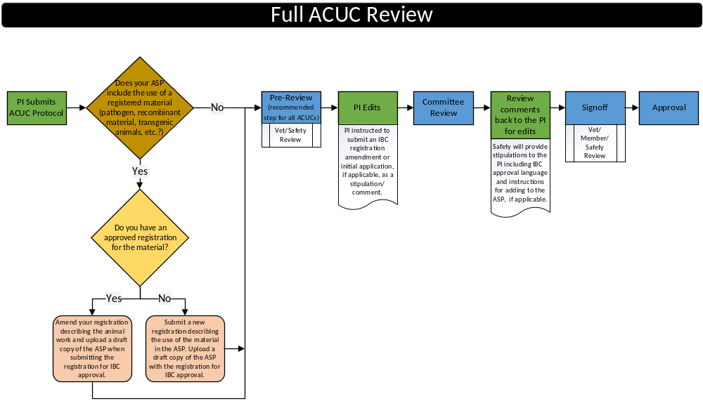
ASP Process Review
Notes:
ACUC review of the ASP and IBC review of the registration documents can occur simultaneously. Delays in submission of registration amendments and/or new registration documents during the ASP review process will delay the final signoff of the ASP. Please submit registration documents through HealthRX as early as possible to avoid delay.

Slide 10
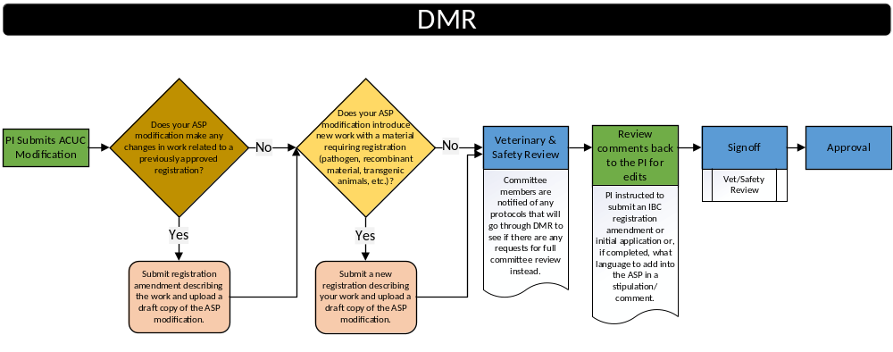
ASP Process Review

Slide 11
Registration Decision Tree
Work with the following requires a new registration:
new infectious agent, toxin
new rDNA work that falls under the NIH Guidelines
Submit a registration for IBC review
Approved work
(in vitro)
Used in animals?
NO
Submit a registration and include draft ASP/ASP modification for IBC review
}
Approved work
(in vivo)
YES
Submit an ASP (initial or modification) describing use of agent for ACUC review
Initial Registrations
Notes:
Center graphics
Pathogen Registration Document - PRD
&
Registration Document (rDNA work) - RD
Principal Investigators must register for work
PRIOR to starting experiments
Must be completed by the PI/proxy and submitted through HealthRx when research is conducted with blood, body fluids, tissues, pathogenic bacteria, viruses, toxins, recombinant DNA, Select Agents, fungi, prions and protein toxins, as well as animals that are infected with BBP and Macaque non-fixed tissue, body fluids and primary cell cultures.

Slide 12
Registration Decision Tree 2
The following situations require a registration amendment:
Addition of a new infectious strains, genes, or significant changes to procedures with an agent
Addition of new ANIMAL WORK
3-year renewal of ASP
Submit an amendment to existing registration for IBC review
Approved work
(in vitro)
Used in animals?
NO
Submit an amendment and include draft ASP/ASP modification for IBC review
Approved work
(in vivo)
YES
Submit ASP (initial or modification) describing new work for ACUC review
Notes:
When submitting a registration amendment, add a clear description of any changes that are being made in the registration. If no changes are being made (ex. 3-year renewal of protocol with no changes to registration work) state that explicitly when submitting the amendment and upload the draft ASP to the registration. Simply stating “Add ASP” will not be sufficient information for the Biosafety Officer to process the requested amendment.

Slide 13
References
Biorisk Management Branch –
Branch Chief
  Jeff Potts, ​Pottsj@mail.nih.gov
Chief Biosafety Officer
  Dr. Richard Baumann, Baumannrg@od.nih.gov
Assoc. Biosafety Officer
  Dr. Althea Treacy, Althea.treacy@nih.gov
Select Agent Responsible Official
  Dr. Carolyn Buckwalter, Carolyn.Buckwalter@nih.gov
IBC Coordinator
  Michael Kujawa, Michael.Kujawa@nih.gov
-

