Slide 1
Wellness Workshop: Setting Boundaries & Work-Life Balance
July 24, 2024

Slide 2
Agenda
1 | Understanding Stress
2 | Reflecting on Work-Life Balance
3 | Setting Boundaries
4 | Resources

Slide 3
Understanding Stress

Slide 4
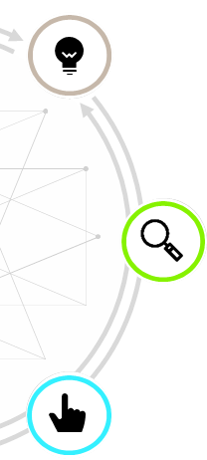
Importance of Work-Life Balance
THE DATA
77% of workers reported they experienced work-related stress
92% said that it is very or somewhat important their organization provide support for mental health
Overall
Stress
57% reported negative impacts from work-related stress like emotional exhaustion
Negative Impacts
26% reported a lack of desire to do their very best
29% of workers said their employers offers an employee assistance program
35% of professionals say their workplace offers a cultures where breaks are encouraged
Available
Resources
2023 Work in America Survey: Workplaces as engines of psychological health and well-being (apa.org)

Slide 5
The Process of Stress
Stress has served many purposes throughout evolution, and at times it can be fuel, while other times it can wreak havoc on the body.
Past Stressors
What is Stress?
The physical and emotional response to an external stimuli that triggers a “fight or flight” response, which is crucial in moments of survival.
What Happens When Stressors are Triggered?
The hypothalamus activates the Sympathetic Nervous System, which can increase heart rate and pulse, shorten breath, tighten muscles, increase eyesight to improve focus, and slows down digestion .
Current Stressors
Why is this important?
These effects are activated so that your body and focus and quickly to “survive” for a short period of time, and often requiring a physical response to return to a steady place.
When stress becomes chronic, it can cause a wide range of health problems.
https://www.nccih.nih.gov/health/stress
https://www.health.harvard.edu/staying-healthy/understanding-the-stress-response

Slide 6
Chronic Stress Can Lead To…
When stress goes unaddressed, it can manifest into more serious issues that can require professional assistance. Read below for some of the issues that can develop when stress goes unmanaged.
Depression and Anxiety
Stress hormones released consistently over a long span of time can cause more serious issues such as depression and anxiety.
Delayed Brain Function
Consistent stress can prevent the amygdala from creating and saving memories which can negatively impact your memory over time. It can also cause headaches.
Inflammation
Digestive issues are the most common side effects that come from chronic stress, causing inflammation that leads to poor digestion.
Lack of Sleep
The release of the stress hormone cortisol before bed can prevent your heart rate from slowing down and can cause trouble sleeping.
https://newsinhealth.nih.gov/2014/12/feeling-stressed

Slide 7
Reflecting on Work-Life Balance

Slide 8
Discussion: Use annotation, chat, or come off mute
Why is it important to you to maintain work-life balance?

Slide 9
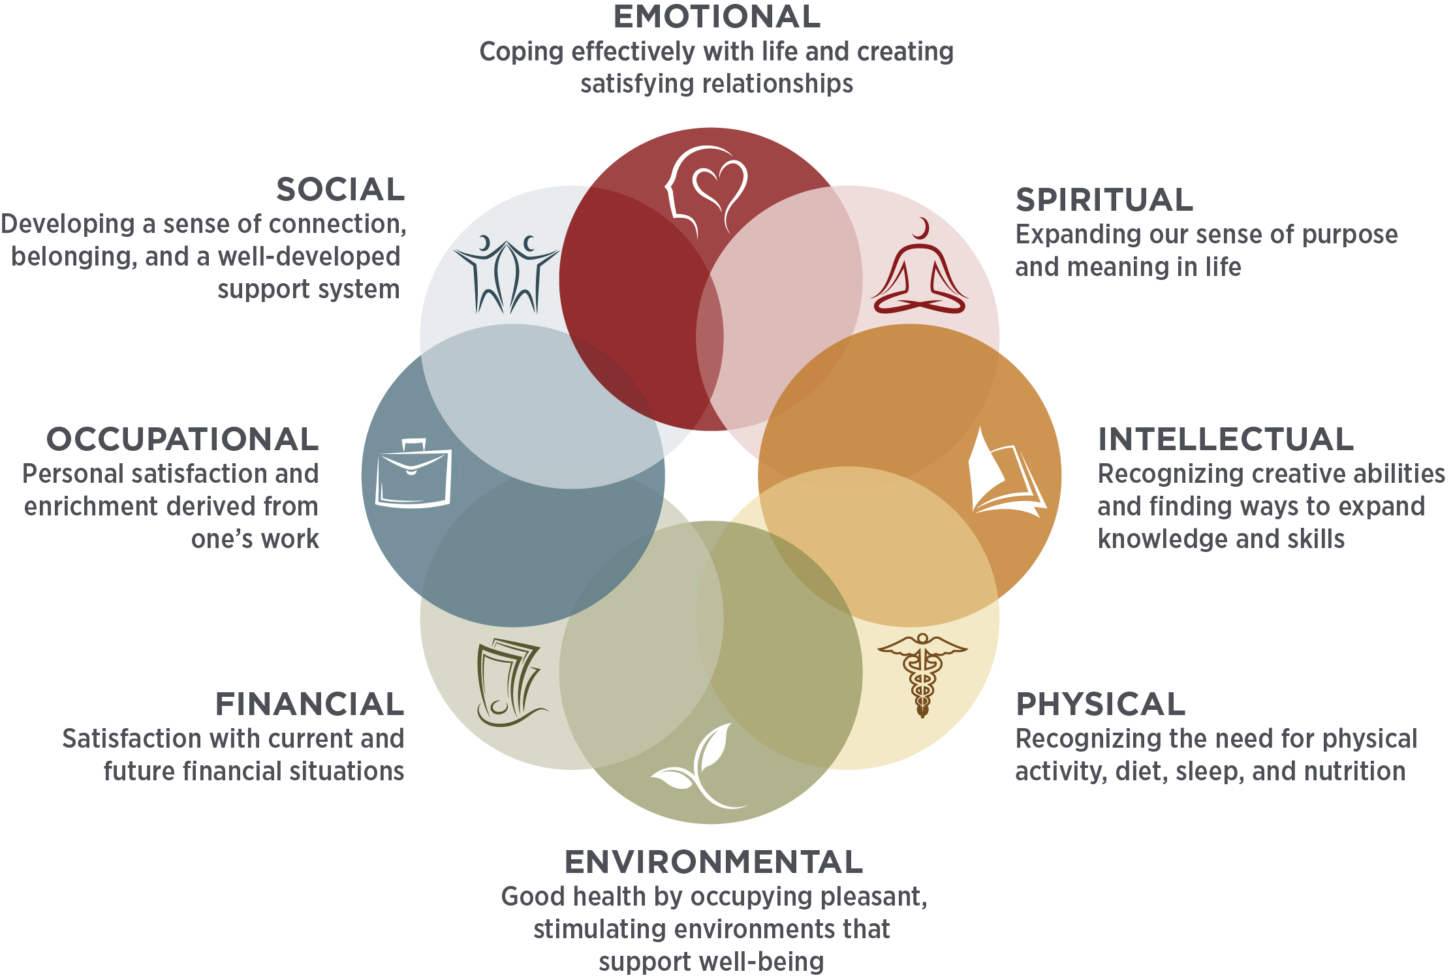
8 Dimensions of Wellness
The 8 Dimensions of Wellness serve as a framework that approaches wellness through a holistic, personal, and multidimensional lens. Each dimension builds on the others to create a well-rounded mindset of resilience that you can leverage during difficult challenges.
The following slides offer general tips to consider when personally considering each dimension as well as NIH resources to support your well-being.
SOURCE: Adapted from Swarbrick, M. (2006). A wellness approach. Psychiatric Rehabilitation Journal, 29(4), 311–314.

Slide 10
Prioritizing Work-Life Balance
In an interview with Brené Brown, research professor and best-selling author on subjects such as leading with courage, she shared that her personal measurement for balance is to assess the following four themes. These help us prioritize balance in our present moments, especially in moments when achieving wellness and balance seems overwhelming.
1
CONNECT WELL
3
MOVE WELL
2
4
SLEEP WELL
EAT WELL
If you feel out of balance, consider addressing any of the following themes that might be a contributing factor.

Slide 11
Exercise: Use Annotation Icon
1
CONNECT WELL
3
MOVE WELL
4
2
EAT WELL
SLEEP WELL

Slide 12
Setting Boundaries

Slide 13
How Do I Set Boundaries?
Setting boundaries requires a few moments of discomfort but ensures that you respect yourself and allow others to treat you the way you want to be treated.
“
Daring to set boundaries is about having the courage to love ourselves even when we risk disappointing others.
- Brene Brown
Professor, Researcher, Author
“

Slide 14
Types of Boundaries
Four of the main types of boundaries are physical, mental, emotional, and time. See below for more information about each of the boundary types.
Physical
Mental
Emotional
Time
Your needs for personal space, and physical needs like needing to sleep, eat, move, and drink water.
Your needs to protect your intellectual individuality including your thoughts, beliefs, and values.
Your needs for emotional vulnerability and to be valued, seen, and respected as a person with worth.
Your needs to own your own schedule and decide how to prioritize your time and who and what to spend it on.
Crossing These Boundaries Can Look Like..
Touching someone without their permission
Invading someone’s personal space
Speaking over other people
Preventing people from proper rest, food, water, etc.
Giving someone gifts they are uncomfortable with
Crossing These Boundaries Can Look Like..
Belittling someone because you disagree with them
Taking someone's ideas and presenting them as your own
Disrespecting someone's intelligence
Patronizing someone
Undermining someone in the workplace
Crossing These Boundaries Can Look Like..
Gaslighting someone and denying their reality
Manipulating someone
Spreading lies about someone
Calling someone names or being hurtful
Attempting to undermine someone to their peers, boss, or loved ones
Crossing These Boundaries Can Look Like..
Expecting someone to be in constant contact despite their other priorities
Scheduling a meeting with someone when they have a calendar block
Showing up late consistently to scheduled events
Not showing up to events without letting people know
https://www.berkeleywellbeing.com/boundaries.html
https://www.mindbodygreen.com/articles/six-types-of-boundaries-and-what-healthy-boundaries-look-like-for-each

Slide 15
Set Boundaries in the Workplace
Below are some of the ways that you can set healthy boundaries for yourself and your teams.
Self-assess and identify the people and situations that cause you stress
Take a moment before responding to requests
Speak to your supervisor
Flex your ‘No’ muscle
Use the Eisenhower Matrix to address your to-do list:
Do it
Defer it
Delegate it
Drop it
Create structure with established agendas in meetings and utilize your calendar as a “boundary tool”
Work with your team on priorities
Set boundaries for yourself
Clearly communicate boundaries and reinforce them
Prepare for some pushback and prepare a response.
https://www.forbes.com/sites/carolinecastrillon/2019/07/18/10-ways-to-set-healthy-boundaries-at-work/?sh=32befb007497

Slide 16
When to Set a Boundary
The most important aspect of boundary setting is identifying when a boundary needs to be set.
You May Want to Set a Boundary If You Are…
Feeling chronically taken advantage within your boundaries
Not asking for what you want in order to avoid conflict
Engaging in people pleasing behavior to receive approval
Symptioms of headaches, stomach aches, or physical discomfort when discussing certain topics
Changing your personality to fit an expectation
Saying "yes" to please others instead of being true to yourself
Avoiding standing up for yourself even when you feel disrespected
Allowing people to invade your personal space
Feeling nervous to participate in meetings because of a certain dynamic
https://www.realsimple.com/health/mind-mood/emotional-health/how-to-set-boundaries

Slide 17
Tech Boundaries in the Workplace
By modeling well-being, you demonstrate that health – both mental and physical – is a priority in this workplace.
Model Good Tech Hygiene
Discuss Which Channels Work Best
Set Expectations
Set “out of office” messages to send when you are out of the office or when you have blocked off time for half a day or more.
Leverage your calendar by blocking off time for work. This helps maintain focus without being disturbed by emails or messages.
If you are going to work late or on weekends, schedule emails to send during regular work hours.
Have intentional conversations with your team about whether to have certain discussions over Teams, Zoom, or Email.
Check in with your team about zoom fatigue and monitor tech well-being.
Create a general understanding about appropriate attire, video status, etc when in meetings both internally and externally.
Schedule and communicate meeting cadences for external and internal meetings
Discuss timeline expectations clearly and directly
Designate “open-door” hours where people can schedule time with you
Encourage transparency about well-being needs and how to leverage technology to create the best environment for each team member.
https://www.nytimes.com/2021/06/23/technology/personaltech/hybrid-workplace-tech-tools.html

Slide 18
Combat Burnout with Scheduling
Alleviate your symptoms of chronic stress and reverse the effects by following the research-proven
3M system which includes micro, meso, and macro breaks.
Micro Breaks
Meso Breaks
Macro Breaks
Daily micro breaks can help you refocus. Micro breaks consist of taking active rest breaks multiple times a day. A few ways to spend a micro break include meditating, taking a shower, or going for a short walk.
Meso breaks provide a way to break up the typical work week and allow you to disconnect from work. For a good meso break, taking off 1-2 hours per week. Meso breaks are perfect for a long walk, seeing friends, or spending time on a hobby,.
Finding time to take a full day off per month can be difficult, but it can be extremely effective to rejuvenate and reenergize you. Macro breaks can involve a weekend trip, spending the day with family, or a day for self-care.

Slide 19
How to Hold Yourself Accountable
Once you’ve set your boundary, the next step is maintaining it.
The following tips details on how to minimize discomfort while keeping the boundary in place.
Find a Partner
Plan for Success
Don’t Wait
Be Honest
Ask someone you trust to help hold you accountable. Check in frequently to ensure you feel supported and encouraged.
Understand that there may be pushback and have a response in place in case your boundaries are crossed.
Don’t wait to have a boundary setting conversation. Have the conversation when you can still do so from a calm and collected place.
Be honest with yourself and the people around you about what your needs are and how people can best respect you. Be open to the needs of others as well and make sure the respect goes both ways.
https://www.forbes.com/sites/forbescoachescouncil/2021/08/04/five-immediate-steps-for-holding-yourself-accountable/?sh=180eded733cc

Slide 20
Maintaining Boundaries
When maintaining boundaries, start small.
Once you become more comfortable communicating your needs, begin to incorporate more.
Boundaries
Maintaining
Communicating
Once you’ve set your boundaries, begin the process of maintaining them. Maintaining boundaries is an ongoing process and your boundaries may change over time.
Once you’ve set boundaries for yourself, ensure you are communicating them to others. This is an ongoing process, so people are aware of your boundaries and are informed when they change.
https://www.strategy-business.com/article/How-healthy-boundaries-build-trust-in-the-workplace# https://www.forbes.com/sites/shanesnow/2020/04/13/how-to-set-boundaries-at-work-when-its-hard-especially-when-remote/

Slide 21
Talking to Your Supervisor
Don’t assume your boss is aware
Know that you are not alone
Come prepared with solutions
Take ownership of your health
Your supervisor may not be fully aware of your workload
Strong leaders understand the value in prioritizing well-being.
If you don’t speak up, they won’t be able to help.
If feeling burned out, have a dialogue with your supervisor.
Many supervisors have been burned out themselves, so chances are, they will empathize with your situation and offer advice.
If you find that communicating with a supervisor is too daunting, reach out to trusted colleagues, or NIH resources such as EAP.
Make it easier for your supervisor to support you by communicating your needs and providing potential solutions for your and your team.
Examples include establishing ‘mental health breaks’, re-structuring the workload, connectivity events, and more.
It’s up to you to prioritize your well-being.
Set appropriate boundaries and make time for your well-being, whether it be regular 15- minute walks, connecting with friends and family, taking deep breaths, etc.
Don’t let burnout go untreated.
https://www.forbes.com/sites/carolinecastrillon/2021/02/21/how-to-talk-to-your-boss-about-burnout/
https://www.today.com/tmrw/how-talk-about-mental-health-concerns-your-boss-t228028/

Slide 22
Handling Boundary Setting Conversations
When done correctly, setting boundaries can be a catalyst for a healthy working dynamic. Use the tips below to maximize the benefits of communication and minimize the possible miscommunication and tension.
DO
DO Expect a Positive Outcome
DO Prepare Important Topics
DO Be Direct and Respectful
DO Be Curious and Empathetic
DO Slow Down and Speak Clearly
DO Sit in an Open Posture
DON’T
DON’T Wait to Have a Conversation
DON’T Rush Before You’re Ready
DON’T Prepare a Script
DON’T Make Assumptions
DON’T Use “Always” or “Never”
DON’T Yell or Cross Your Arms
How to Have Difficult Conversations When You Don’t Like Conflict (hbr.org)
4 Things to Do Before a Tough Conversation (hbr.org)
How to Handle Difficult Conversations at Work (hbr.org)
Words and Phrases to Avoid in a Difficult Conversation (hbr.org)

Slide 23
Discussion: Use annotation, chat, or come off mute
What are tips that you have found helpful in striving for Work-Life Balance?

Slide 24
A Mindful Moment

Slide 25
Resources

Slide 26
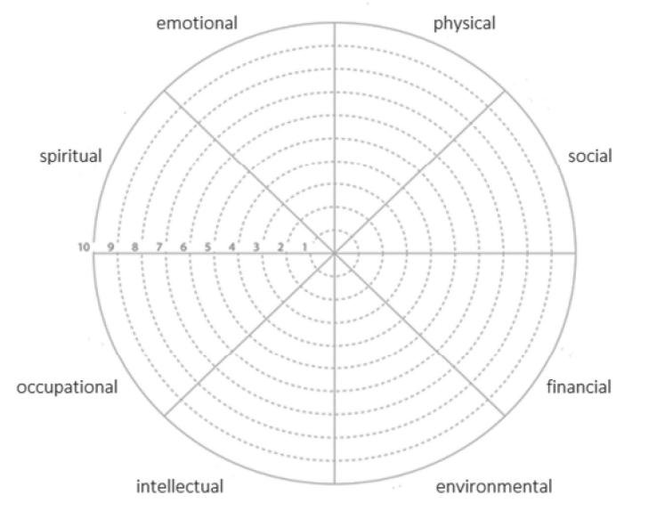
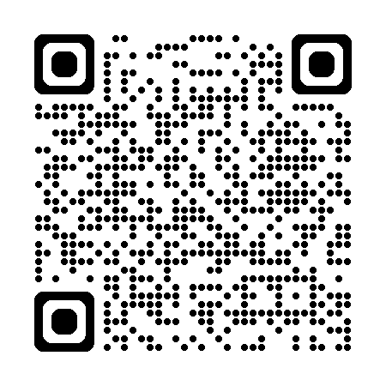
Self-Care Wheel
The Exercise
Chart where you are today
Using a 1-10 rating, connect the dots, visualize strengths and areas to improve
Reflect and set goals
Create three SMART goals and place the wheel somewhere you see it often
Check progress
Check in with yourself monthly and repeat the process
Scan the QR Code
Use this resource in the future

Slide 27
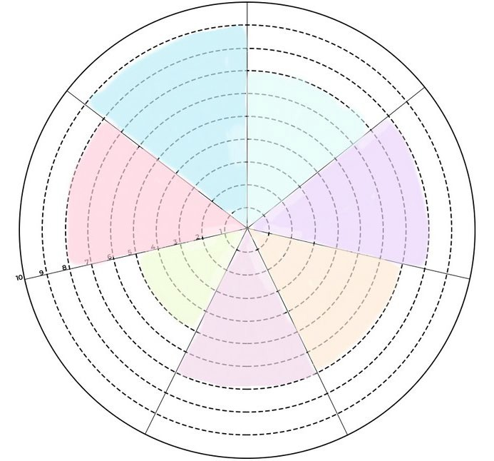
Drawing Self-Care Wheel
You Choose

Slide 28
Wellness@NIH Resources
Wellness@NIH is here to help you achieve your wellness goals and enhance your well-being.
Areas of Support from Wellness@NIH
NIH Joins the Mindful FED Program
Fitness
Mindfulness & Resiliency
Food & Nutrition
Work-Life
Health & Safety
Mental Health
Ways to Participate in Mindful FED
Join the Mindful FED Listserv: Federal employees can send a blank email to receive weekly invitations and resources
Attend NIH’s Mindful FED Offering every Thursday at 2pm
Listen to "Mindful Musings" Audio Blog Series
Participate in the Weekly Class Schedule
View and attend any Inter-agency Offerings
Register for the Mindful Approaches to AI Webinar Series
With a new Mindfulness & Resiliency page and a newsletter that’s now monthly, Wellness@NIH is ready to support you!

Slide 29
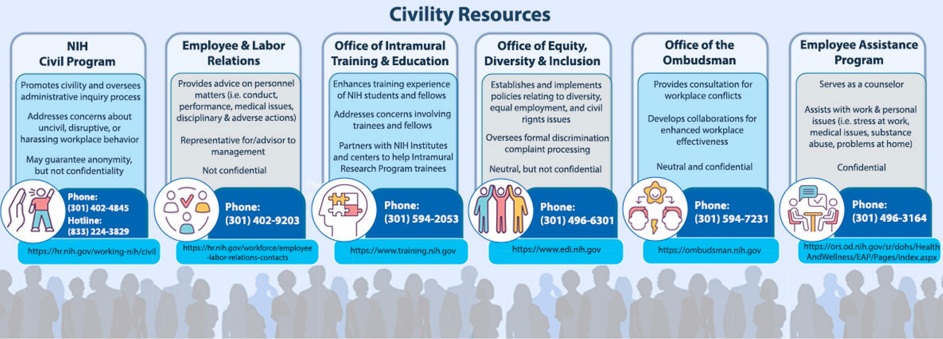
Resources at NIH

Slide 30
Connect with Wellness@NIH
Connect With Us
Prioritize Your Wellness
and Join The
Wellness@NIH Community!
Wellness@NIH Website
Wellness@NIH Newsletter
NIH R&W Website
Wellness@NIH Listserv
Wellness@NIH Facebook Group

