Slide 1




Transportation Services Branch
Building 31, A Wing, 1st Floor, Room 1A11
Tel: (301) 496-5050 Fax: (301) 480-0854
E-mail: nihparkingoffice@nih.gov
LUNCH AND LEARN: NIH PARKING AND
ALTERNATIVE COMMUTING OPTIONS
February 26, 2025
Transhare Program
Parking Program
Notes:
Due to parking constraints, summer student parking is located at the Montrose lot
Transportation Service can issue you a parking hanger which will provide you with access to student employee parking
Transhare benefits
Biking
Public transit
If you are receiving Transhare benefits, you have to give up you hang tag – however you are able to obtain up to 6 temporary parking permits per quarter

Slide 2
Transportation Services Branch
Agenda:
Transhare
RideShare – Carpool/Vanpool
Shuttles
Parking
Campus Safety
Pre-Enrollment
Enrollment

Slide 3
NIH Transhare Program
Employees, Fellows, Volunteers, and Summer Students are eligible for the NIH Transhare Subsidy Program, which offers benefits of up to $325 per month. The transit benefits are provided through WMATA’s SmarTrip card program.
Key points about the program:
Subsidies can only be used for mass transit.
Commuter costs are based on the distance from a local home address to work, covering up to 20 commuting days per month.
Commuters using MTA, MARC, VRE, and vanpools may qualify for benefits up to $325.
Benefits are automatically loaded onto registered SmarTrip cards on the 1st of each month.
Note: Apple and Android devices can be used on Metrorail and buses.
Pre-Enrollment
Enrollment
Badge Issuance

Slide 4
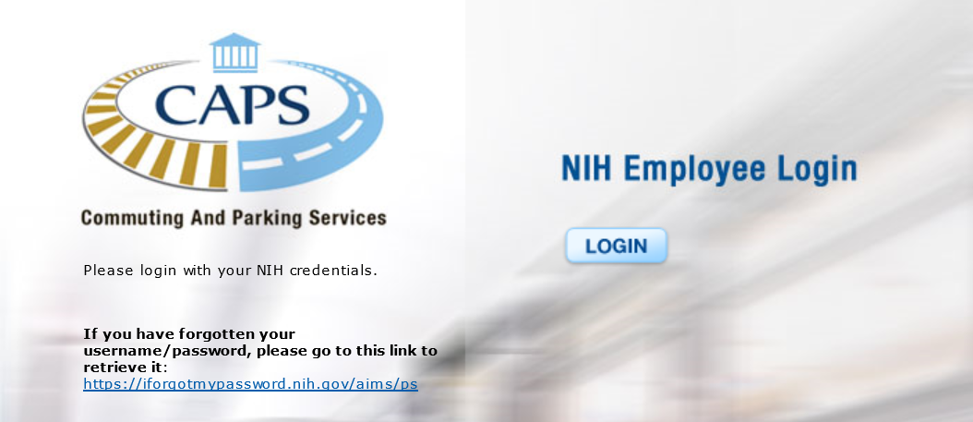
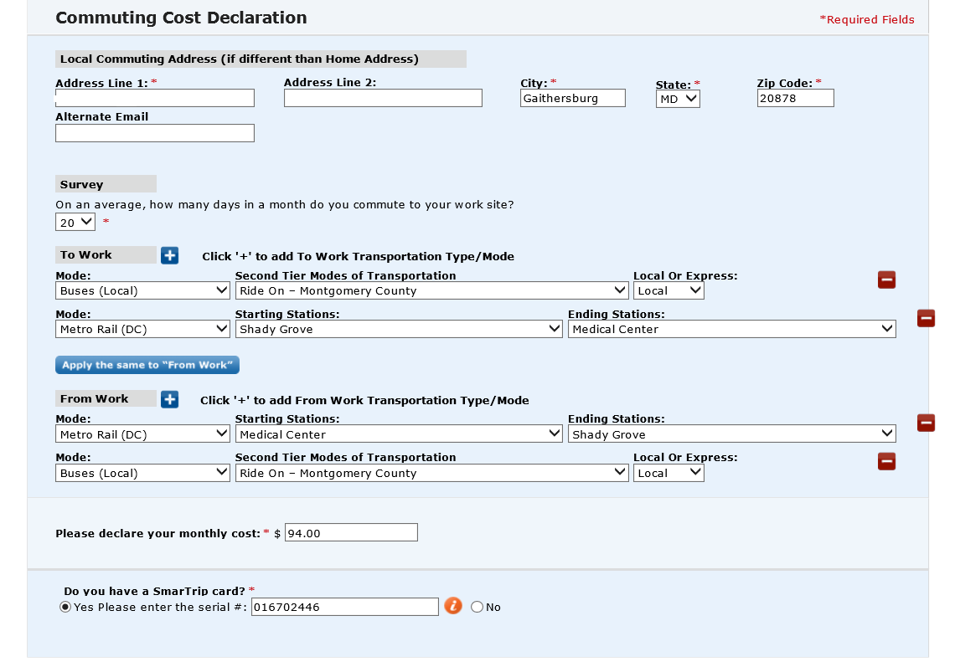
Completing Commuting Cost Declaration in CAPS
Once logged into CAPS, enter the following information:
Your local home and commuting (work) addresses;
Average days of work (20 days is the normal schedule, which excludes holidays and weekends);
Enter transportation mode (bus, metro station, etc.);
To calculate your commuter cost, use the WMATA Trip Planner tool at wmata.com/schedules/trip-planner.
Employees’ transit subsidies are for commuting from local addresses to work; any other trips outside of work are the employee’s responsibility.
Pre-Enrollment
Enrollment
Badge Issuance

Slide 5
NIH Transhare Program Continued
Employees using MARC, MTA, or VRE may purchase monthly passes by allocating their subsidies to third parties, such as MTA CharmPass App or CommuterDirect.com. SmarTrip cards do not work on these commuting systems. SmartBenefits allocations must be completed by the 15th of the month.
Employees unable to access the CAPS online system to enroll; email a completed Enrollment Form to the Employee Transportation Services Office at nihparkingoffice@nih.gov.

Slide 6
NIH RideShare Program
The NIH RideShare program helps NIH employees, contractors, fellows, guests, and volunteers find carpool partners and assists vanpool coordinators in locating riders. The program matches individuals based on their home locations and work sites.
How it works:
Enroll in RideShare by entering your work schedule and flexibility.
Search for nearby members in the database.
Contact them via email through the CAPS system.
Coordinate carpool details once connected.
Register with the Guaranteed Ride Home program from Commuter Connections! This free service ensures you will never be left stranded at work!
Enroll online through CAPS by logging in with your NIH PIV Card at https://commuter.ors.od.nih.gov
Pre-Enrollment
Enrollment
Badge Issuance

Slide 7
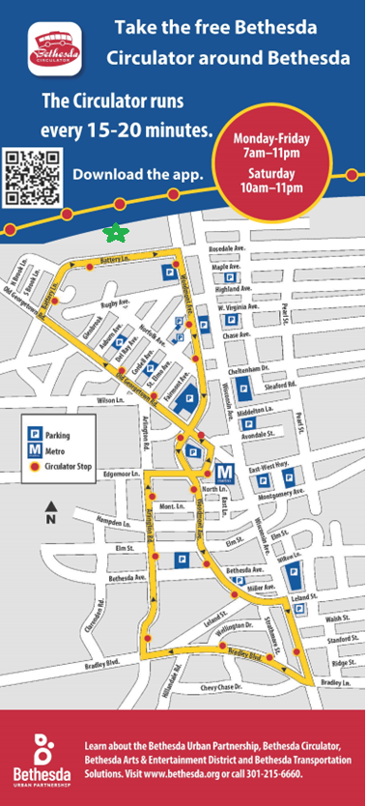
NIH Transportation Outreach
Below is a summary of our outreach initiatives to support employees returning to work:
Webinars:
  Rockledge Commuter Options Webinar – March 5, 2025
  Executive Blvd. Commuter Options Webinar – March 12, 2025
  Bethesda Campus Commuter Options Webinar - TBD
Tabling Events:
  Bldg. 10S Lobby – March (date TBD)
  Bldg. 31A Lobby – March (date TBD)
  Bldg. 35 Lobby – March (date TBD)
  Rockledge I – March 19th (date TBD)
DATS partnering with Montgomery County Transportation Management Districts (TMD) – Bethesda Transportation Solutions and North Bethesda Transportation Center (Rockledge areas) to offer commuting solutions for NIH employees.
  Free Bethesda Circulator from Downtown Public Garages to Battery Lane (NIH Ped entrance)
  Personalized commute planning assistance through TMD Commute Services
  Capital Bikeshare Capital Bikeshare DC
  RideShare Network via COMMUTER CONNECTIONS
  Guaranteed Ride Home for those using public transportation twice a week (Sign up through COMMUTER CONNECTIONS)
  Commuter Cash App: Helps with trip planning, finding carpools, and earning rewards.
  MCDOT Park-N-Rid Lots in Montgomery County
  The county provides numerous incentives available for the public, including Pool Rewards for carpooling or vanpooling, and more.
Pre-Enrollment
Enrollment
Badge Issuance

Slide 8
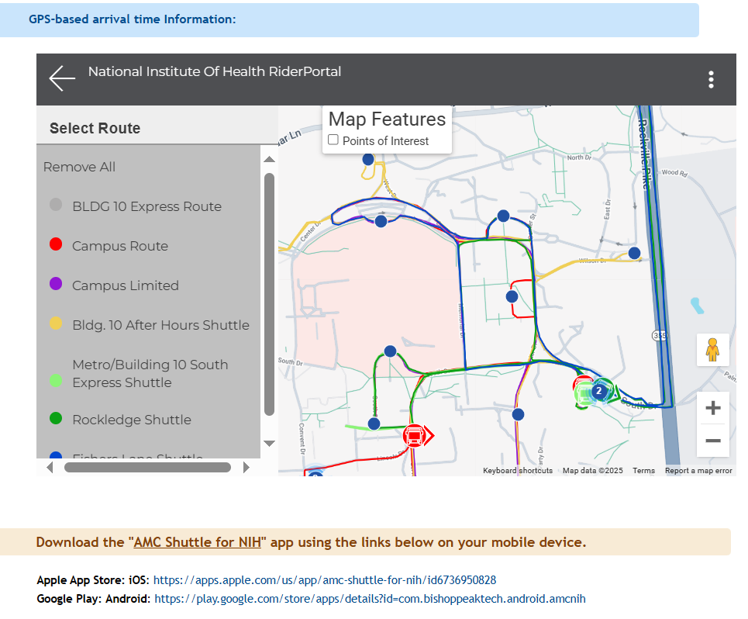
NIH Shuttle Service
    The NIH provides a free, GPS-equipped shuttle service to the NIH facilities around the campus.
    Employees can view real-time shuttle arrival times, maps, and schedules using mobile devices at NIH Employee Shuttles.
    All Shuttles are equipped with ADA accessibility, bicycle racks, and security video cameras.
Pre-Enrollment
Enrollment
Badge Issuance

Slide 9
NIH Parking
All employees are required to have a valid parking permit. If you have not renewed or applied for a permit, you may apply for one on the Commuting and Parking Services (CAPS) https://commuter.ors.od.nih.gov/.
Can't find your NIH Permit or it's lost?
  Submit a “Report Lost Hanger” through the CAPS system. A new permit will be mailed to your home address, and a temporary 2-week permit will be emailed to you for immediate use.
Parking members are not eligible for any other transportation subsidies.
With limited parking available on the NIH Campus, we encourage eligible employees to use the Transhare program or carpool.
Pre-Enrollment
Enrollment
Badge Issuance

Slide 10
NIH Division Of Police
NIH Campus Safety
Presenter
Matt Mehlhaff,
Community Officer
Pre-Enrollment
Enrollment
Badge Issuance

Slide 11

Questions?
Division of Amenities and Transportation Services
Michelle Mejia
Program Manager,
NIH Parking Office
Building 31/1A11
301-496-5050
mejiam@nih.gov
Pre-Enrollment
Enrollment
Badge Issuance

