Slide 1
Customer Assessment
Office of Quality Management
Office of Research Services
National Institutes of Health
October 2005

Slide 2
For more information on Performance Management in the Office of Research services:
http://www.ors.od.nih.gov/OD/OQM/Pages/index.aspx
Or Contact:
Antonio Rodriguez
Rodrigan@mail.nih.gov
(301) 402-3440
Acknowledgments
This training was developed by SAIC and the Office of Quality Management.

Slide 3
Training Objectives
Introduction
  Customer Assessment and Performance Management
  Customer Relationship Management
The 10 Steps
Conclusion

Slide 4
Customer Assessment and Performance Management
The Balanced Scorecard for Your Organization
How do we exceed
Customer/stakeholder expectations?
Customer
What do our customers/
stakeholders look for in financial results?
Financial
Strategy
Internal
What process do we need to improve to fulfill these expectations?
Learning
What skills, tools, and culture are required to perform these processes?

Slide 5
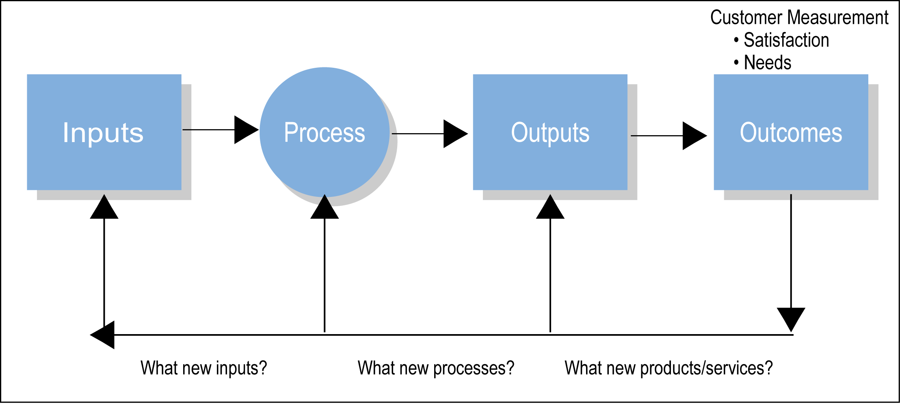
Performance Measurement Model
What inputs?
What processes?
What products/services?

Slide 6
Customer Intimacy Is Customer Quality Relationships
Understand their business
Know their needs
Provide complete solutions
Quality of the relationship
Empower them
Share with them
Our team knows their team
Follow up and feed back

Slide 7
Examples of Customer Objectives
ORS and ORF EXAMPLE
OBJECTIVES
Provide integrated transparent access to the most relevant information via the most effective information sources for NIH researchers and staff
Improve education of customers on portfolio of services offered by Events Management
Be readily available to our customers to provide information, customer service, and resolve issues regarding transportation and parking services
Improve communication with customers
Meet customer needs by providing the right mix of specialized research support services
Improve customers’ business decisions
Improve as single-source contact on ORS-wide administrative processes
Increase responsiveness to customers’ varying needs
Increase customer satisfaction with our products and services

Slide 8
Customer Relationship Management (CRM)
Customer measurement a piece of CRM
  Describes the many activities in managing relationships with customers
What is a relationship?
  Continuing series of collaborative interactions
  Occurs over time
  Develops based on successive interactions
  Unique for each customer
Why management?
  Each interaction offers:
    Ability to customize products/services to customers
    Opportunity to influence customers’ perceptions
    Learn more about customers for the future
  Management of relationship encourages loyalty

Slide 9
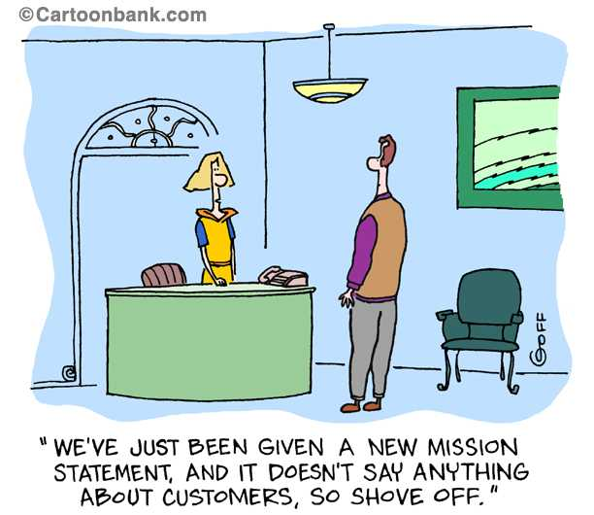
© 2001 The New Yorker Collection from cartoonbank.com. All Rights Reserved

Slide 10
Why should YOU care about managing customers?
Times have changed
  Customers have escalating needs
  Competitors are delivering on these demands
  If you don’t, you will be out of business
  Computer technology has contributed to this new world
Business Case
  Dissatisfied customers usually don’t complain
  Dissatisfied customers usually do defect
  Dissatisfied customers tell everyone they know
  Dissatisfied customers encourage others to defect
  Result --- lost business…..forever!!

Slide 11
Why should ORS/ORF care about managing customers?
Management Case
  NIH stakeholders want to see data
    How ORS/ORF knows we are satisfying customers
    Why ORS/ORF should be the provider of choice
    How ORS/ORF is planning to meet future customer needs
Government Case
  Should ORS/ORF be sole source of products/services
    Can others (government or private) be providers
    Cost important but also value
  GPRA
    Explain in quantifiable terms how serving customers
    Value provided in fulfilling Agencies’ missions
    Why we should continue to receive funding and support

Slide 12
If you can’t measure it, you can’t manage it.

Slide 13
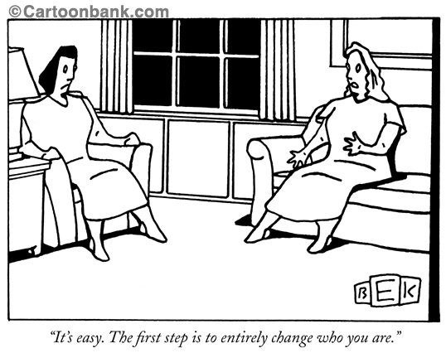
Where do you start?
© 2001 The New Yorker Collection from cartoonbank.com. All Rights Reserved.

Slide 14
The 10 Steps
Select the service area to measure
Define products/services delivered to customers
Identify customer segments
Conduct targeted customer interactions
Research competitors
Select measures
Plan data collection
Gather and analyze customer data
Discuss findings and recommendations
Take action

Slide 15
Step 1
Select Service Areas to Measure

Slide 16
Step 1 (cont.)
Select Service Areas to Measure
Best to prioritize areas to measure
In ORS/ORF, the PMP process is the key to understanding what is important.
Select those that are most important
  What are the “High Impact” objectives?
  In general,
    Visibility to customers
    Complaints concerning quality
    Revenue generated
    High costs of operations
    Desire to understand why product/service is successful
    Initiatives to increase market share
    Requests to demonstrate service usefulness

Slide 17
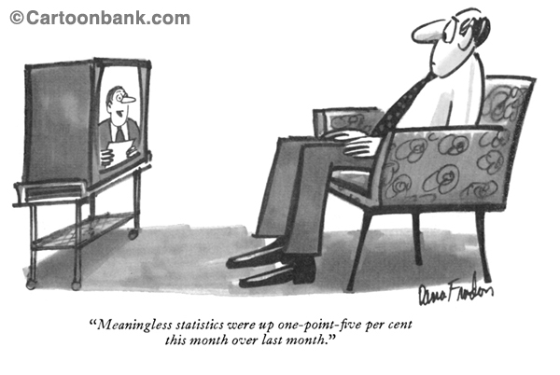
Step 2
Describe Products/Services
© 2001 The New Yorker Collection from cartoonbank.com. All Rights Reserved.

Slide 18
Step 2 (cont.)
Describe Products/Services
Some questions to answer:
  What categories of products/services are delivered to customers?
    Why are some categories used more than others?
  Has the delivery of products/services increased, decreased, or remained constant?
    Why have these changes occurred?
  Are particular NIH ICs using the product/service more than others?
    If so, why?
  Who is ordering, receiving, and using the products/services?
  Do your IT systems provide enough information to answer these questions?

Slide 19
Step 2 (cont.)
Graph what You Deliver to Customers
Example 2-1
  Division of Veterinary Resources (DVR) Procurement Orders Processed by Customer and Fiscal Year
Example 2-2
  Categories of Products Ordered from MAPB by Fiscal Year
Example 2-3
  NIH Transhare Participants by Month
Example 2-4
  FY04 Flow Chart of the Division of Radiation Safety Review of Animal Study Program (ASP) Proposals

Slide 20
Step 2 (cont.)
Example 2-1: FY04 DVR Procurement Orders Processed by Customer and Fiscal Year

Slide 21
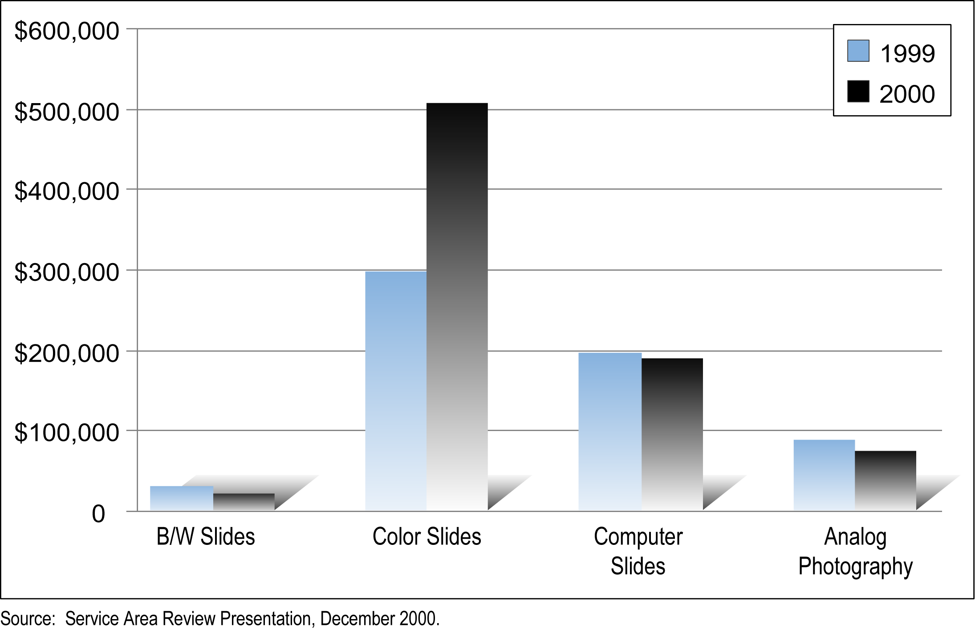
Step 2 (cont.)
Example 2-2: Categories of Products Ordered from MAPB by Fiscal Year

Slide 22
Step 2 (cont.)
Example 2-3: NIH Transhare Participants by Month

Slide 23
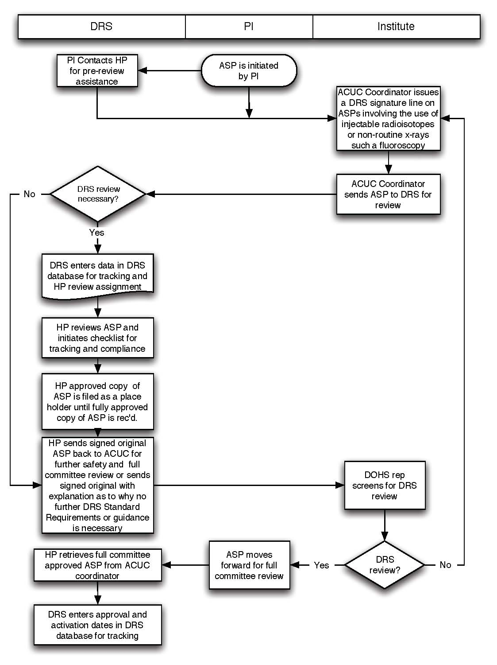
Step 2 (cont.)
Example 2-4: FY04 Flow Chart of the DRS Review of ASP Proposals

Slide 24
Step 3
Identify Customer Segments

Slide 25
Step 3 (cont.)
Identify Customer Segments
Segmentation means to sort customers into groups based on similar characteristics
Critical to the viability of service organizations
Segmentation allows understanding of the differences in customer groups
  What they like - what they don’t like
  How to tailor service offerings to better meet needs of each group
By identifying and tracking customer segments over time
  Determine which segments are most profitable to target and retain
  Determine which segments to deemphasize

Slide 26
Step 3 (cont.)
How do I Segment my Customers?
Use existing data to understand:
  Type of products/services used
  Quantities of use
  Customer’s organization
  Customer’s function
  Other demographic variables
    Location
    Type of business
    Delivery schedule

Slide 27
Step 3 (cont.)
Graph Data to Understand Customer Segments
Example 3-1
  Library Translation Customers by Fiscal Year
Example 3-2
  FY04 Division of International Services (DIS) Visas Processed by Type

Slide 28
Step 3 (cont.)
Example 3-1: Library Translation Customers by Fiscal Year

Slide 29
Step 3 (cont.)
Example 3-2: FY04 DIS Visas Processed by Type

Slide 30
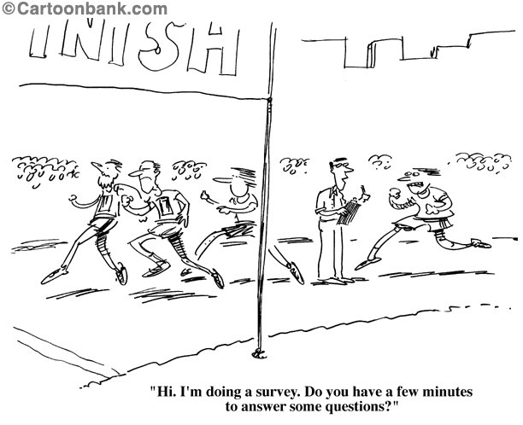
Step 4
Conduct Needs Assessment
© 2001 The New Yorker Collection from cartoonbank.com. All Rights Reserved.

Slide 31
Step 4 (cont.)
Conduct Needs Assessment
Existing data may not reveal what matters most to customers
  Providing what customers really need vs. providing what you think customers need
Needs Assessments allow you to learn more about your customers
  First review data from prior steps
  Look at additional sources – e.g. complaints, stakeholder input, data showing a particular service is over/under-used
  Develop list of questions
  Gather data via:
    Targeted interactions
      Interviews
      Focus Groups
    Survey of customers

Slide 32
Step 4 (cont.)
Conduct Needs Assessment (cont.)
  Example 4-1
    FY04 Animal Program Advisory Committee (APAC) Feed and Bedding Focus Group
  Example 4-2
    FY04 Scientific Equipment and Instrumentation Branch (SEIB) Needs Assessment survey

Slide 33
Step 4 (cont.)
Example 4-1: APAC Feed and Bedding Focus Group (Slide 1 of 3)
Division of Veterinary Resources (DVR) Basic Animal Life Support Service Group analyzed data regarding its feed and bedding processes
  FY02 and FY03 data suggested that the acquisition and storage of feed and bedding products as well as the quality assurance testing of these products should be further examined – especially with respect to customer needs
  A focus group was held with APAC members in FY04 to gather data on customer needs

Slide 34
Step 4 (cont.)
Example 4-1: APAC Feed and Bedding Focus Group (Slide 2 of 3)
A structured series of questions were asked of members and action items generated based on the data gathered
    Is the current ordering process for feed and bedding products working? Explain.
    Currently how confident are you that you can get feed and bedding when you need it?
    Have you had problems related to the delivery of feed and/or bedding?
    Have you found the OLAO staff to be responsive to your needs?
    Have you had ongoing issues related to the quality of either the feed or bedding products delivered?
    Do you think NIH should continue to do additional quality assurance checks on feed and bedding products beyond the tests run by the manufacturers?

Slide 35
Step 4 (cont.)
Example 4-1: APAC Feed and Bedding Focus Group (Slide 3 of 3)
    When you have a quality issue, do you contact Dennis Barnard in DVR or do you contact OLAO staff or both?
    Would you find it helpful to have all issues about feed and bedding be handled by one person in DVR? Why or why not?
    Some organizations eliminate their warehousing function as a way to reduce costs, and receive their supplies directly from vendors just-in-time – meaning they receive the products just as they are ready to use them. How would you feel about going to such a system for animal feed and bedding products? Explain.
Customer input verified necessity of current acquisition and storage procedures

Slide 36
Step 4 (cont.)
Example 4-2 : FY04 SEIB Needs Assessment Survey
Survey was designed to determine the need for instrument design and fabrication services among NIH intramural Principal Investigators (PIs)
What was discovered:
  About 90% of all intramural PIs completed the survey
  34% of PIs expressed a need for instrument fabrication and design services
  Almost half of all jobs are urgent or emergencies
  About 40% of PIs used outside sources for design and fabrication work

Slide 37
Step 4 (cont.)
Example 4-2 : FY04 SEIB Needs Assessment Survey (cont.)
Do you require any of the following services for instrument fabrication and design?
66% expressed no need
34% expressed need for instrument fabrication and design (N=320)
N = 935
Number of Respondents
Note: Multiple responses possible in last four categories.
172 respondents skipped this question.

Slide 38
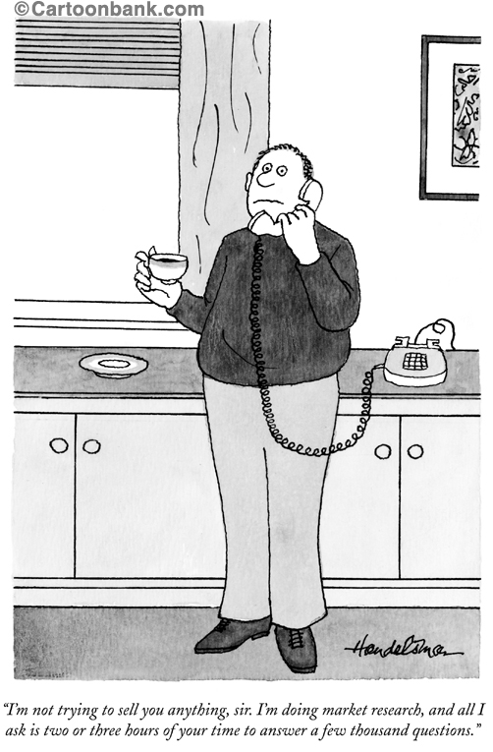
Step 5
Research Competitors
© 2001 The New Yorker Collection from cartoonbank.com. All Rights Reserved.

Slide 39
Step 5 (cont.)
Research Your Competitors
Why should ORS/ORF be the provider of choice?
Ask yourself:
  Who else can provide this service?
  At what cost can others provide this service?
  What does ORS/ORF offer that is unique or valued compared to competitors?
  What do competitors offer in terms of features and amenities that are not offered by ORS/ORF?
  What distinguishes you from your competitors?
  What are you doing to increase market share?
What is the value proposition for your service area?

Slide 40
Step 6
Select Measures

Slide 41
Step 6 (cont.)
Typical Balanced Scorecard Customer Measures
Customer satisfaction
  How well meeting needs and satisfaction with specific performance criteria
Market share
  Proportion of business in market that you provide to customers
Customer retention
  Do you maintain ongoing relationships with customers and retain their business
Customer acquisition
  Rate at which you attract new customers
Customer profitability
  Net profit of a customer segment accounting for unique expenses to support that customer

Slide 42
Step 6 (cont.)
Some Advice About “Measures”
Rarely can you gather data and use it directly to gauge performance
  Data needs to be collected, transformed, analyzed, summarized, and displayed
Most measures are calculated based on a series of raw data metrics
  Customer satisfaction may be the overall satisfaction score on a 20 question survey
  Market share may be combination of percentage of market for variety of products/services
  Customer retention may be combination of retention of many different customers, segments
There is no one “right” measure
Be flexible to change measures
  Example 6-1
    FY05 Division of Facilities Planning (DFP) Customer Scorecard

Slide 43
Step 6 (cont.)
Example 6-1: FY05 DFP Customer Scorecard

Slide 44
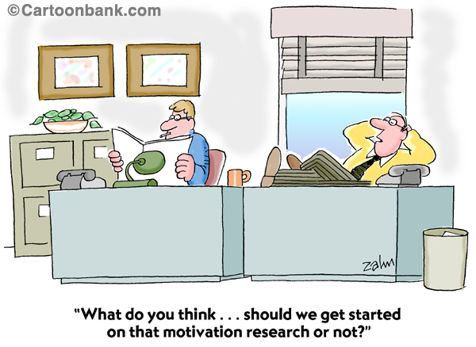
Step 7
Plan Data Collection
© 2001 The New Yorker Collection from cartoonbank.com. All Rights Reserved.

Slide 45
Step 7 (cont.)
THINK Before you Act!
Data collection is a time consuming activity
Gathering data from customers raises their expectations
Only collect the amount of data you can analyze and respond to in timely fashion
Garbage in = Garbage out

Slide 46
Step 7 (cont.)
Methods for Collecting Data
Existing Data
Observation
Interviews and Focus Groups
Surveys

Slide 47
Step 7 (cont.)
Existing Data (cont.)
Financial data, ordering data, delivery data, complaints data
Steps to using existing data:
  Select appropriate data
  Define data into measures
  Determine computational procedures to use measures as information
Example 7-1
  Scientific Equipment Instrumentation Branch (SEIB) Rental Revenue by Fiscal Year

Slide 48
Step 7 (cont.)
Example 7-1: SEIB Rental Revenue by Fiscal Year

Slide 49
Step 7 (cont.)
Existing Data - Advantages
Easy to gather
Doesn’t require involving the customer
Often viewed as “objective” or “real”
Can be summarized over time
Allows quick review of current situation
Typically used to convince management that something needs to change

Slide 50
Step 7 (cont.)
Existing Data - Disadvantages
Quality of the data may be poor - not recorded in consistent fashion
Data may be incomplete
Extraction of data may be time consuming
Not collected with analysis in mind
May have limited usefulness

Slide 51
Step 7 (cont.)
Observations
Simple to do
Great reality check on how things really happen
Very useful to understand new features, amenities you could provide
Example 7-2
  FY05 Security Guard Observations of Wait Times for Vehicle Security Checks

Slide 52
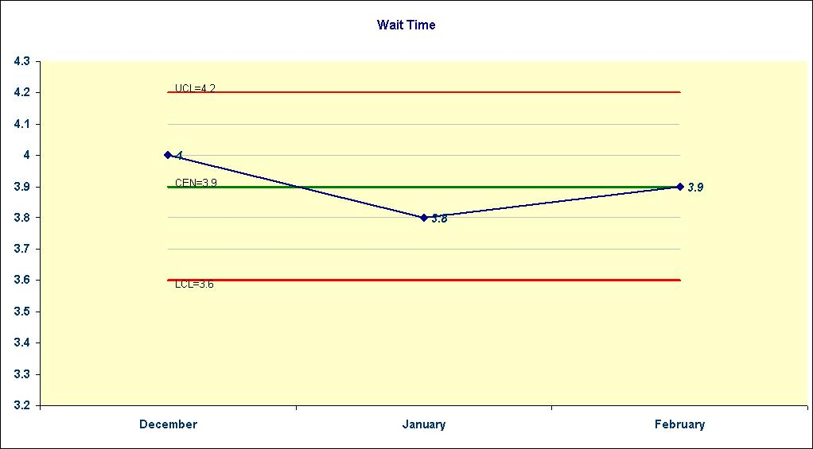
Step 7 (cont.)
Example 7-2: FY05 Security Guard Observations of Wait Times for Vehicle Security Checks

Slide 53
Step 7 (cont.)
Observations - Advantages
Yield real time data
Provide understanding of context
Outsiders can be used so data has little bias
See things that escape notice in general course of work
Access to information people may not want to discuss in interviews

Slide 54
Step 7 (cont.)
Observations - Disadvantages
Can be costly if have to train observers
Limitations due to people’s concerns about anonymity and being observed
Presence of observer may influence process
Can be hard to code and analyze

Slide 55
Step 7 (cont.)
Interviews and Focus Groups
Difference
  Interviews are conducted with individuals
  Focus groups consist of multiple participants
Good for collecting qualitative data
  Information not readily categorized and coded
  Explore why customers feel they way they do
Questions are usually open-ended in nature
  Let customers respond in their own words
  Provides insight into customer perceptions
Example 7-3
  FY03 ORS Financial Management Branch (FMB) Customer Interviews

Slide 56
Step 7 (cont.)
Example 7-3: FY03 ORS FMB Customer Interviews (Slide 1 of 4)
Interviews were conducted with representatives in ORS to capture how the ORS Financial Management Branch (FMB) can provide better service to its customers.
Total of 13 interviews were held and most lasted 1 hour
Combined open ended questions with a structured survey (ORS customer scorecard)
Summary of results were compiled

Slide 57
Step 7 (cont.)
Example 7-3: FY03 ORS FMB Customer Interviews (Slide 2 of 4)
How the results were used:
  FMB took action to clarify its role, especially in the budget reporting process
  FMB was able to partner with Divisions and become a better advocate for them with OFM
  Results helped reaffirm FMB’s commitment to a customer service mentality.

Slide 58
Step 7 (cont.)
Example 7-3: FY03 ORS FMB Customer Interviews (Slide 3 of 4)
Open Ended Questions:
  Business plan formulation questions
    How well do you think the current business plan formulation process works?
    What specific ideas do you have to improve the process?
    What tools or services could the FMB provide to assist you in this process?
  Budget execution questions
    Do the current reports and information you receive meet your needs to track your budget obligations/accruals/expenditures?
    How could the reports/information be modified so you would NOT have to manipulate it to use it?
    How much has timeliness and accuracy of budget execution information been an issue for you?

Slide 59
Step 7 (cont.)
Example 7-3: FY03 ORS FMB Customer Interviews (Slide 4 of 4)
Open Ended Questions (cont.):
  Central Services Questions to be Asked
    Do the current Central Services reports and information you receive meet your needs to track your budget obligations/accruals/expenditures?
    What specific ideas do you have on how we provide this information to you in a useful manner and timeframe?
  Questions for Rate Study Customers
    What services does the Budget and Finance group currently provide for your rate studies?
    What could we do to improve our service to you in this area?
  General
    Do you have any additional specific ideas on how the Budget and Finance Service Group can improve our service to you?

Slide 60
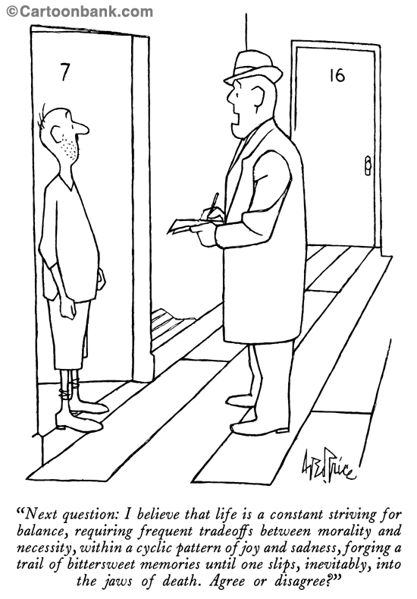
Step 7 (cont.)
Interviewing is a Skill
© 2001 The New Yorker Collection from cartoonbank.com. All Rights Reserved.

Slide 61
Step 7 (cont.)
Interviews/Focus Groups - Advantages
Allow flexibility in data collection
Can gather unexpected data and ask unplanned questions
Provide more complete customer perspective
Facilitate communication and customer relations
Useful for generating ideas for improvement
Allow for problem-solving during the actual meeting

Slide 62
Step 7 (cont.)
Interviews/Focus Groups - Disadvantages
Require skilled interviewers or they can backfire
Produce results that can be difficult to analyze and interpret with assistance
Can produce biased results
Social desirability or peer pressure (focus groups) can be influential

Slide 63
Step 7 (cont.)
Surveys
Doing a good survey is NOT simple
  Obtaining useful information requires skill and practice
The method (e.g. doing a web survey) is just part of the process
Need to consider issues of anonymity and confidentiality
There is no “magical” number of questions
Response rates are key to evaluating surveys -- how the data can be used
Don’t do a survey unless you plan to act on the results

Slide 64
Step 7 (cont.)
Components of a Survey
Introduction
  Reasons for survey
  Guaranteeing anonymity
  Instructions
Survey Questions
  Satisfaction surveys
  Needs assessment surveys
  Climate surveys
Comments
  Offer respondents chance to comment
Closing
  Thank you
  Assurance that results will be made available

Slide 65
Step 7 (cont.)
Introduction
Introduction
  Example 7-4
    FY05 Division of Facilities Planning Customer Scorecard

Slide 66
Step 7 (cont.)
Example 7-4: FY05 Division of Facilities Planning Customer Scorecard
Introduction
The Division of Facilities Planning in the Office of Research Facilities is gathering customer feedback on the planning services it provides ICs so that we know how to better satisfy your needs. Each IC is being asked for one response representing the consolidated views of the IC. Your responses will be combined with the responses of others and analyzed by the Office of Quality Management in the Office of Research Services. Thus the information you provide will remain anonymous. Please take a few minutes to complete this survey.

Slide 67
Step 7 (cont.)
Survey Questions: Customer Satisfaction Surveys
Customer Satisfaction Dimensions
  Common satisfaction dimensions apply to all/most Service Groups
  Use these dimensions whenever possible
  Advantage: Allows OQM to roll-up ratings across Service Groups
  Example 7-5
    ORS Customer Scorecard

Slide 68
Step 7 (cont.)
Example 7-5: ORS Customer Scorecard
Customer Satisfaction Dimensions
Please rate your SATISFACTION with <Service Group or Product Name> on the following:

Slide 69
Step 7 (cont.)
Survey Questions: Satisfaction Surveys
Satisfaction With Specific Performance Aspects
  Satisfaction ratings may be obtained on any aspect of service or product performance
  Work with OQM to define questions
  Example 7-6
    FY05 Space Administration and Finance Branch (SAFB) Consolidated Statement of services (CSS) survey
  Example 7-7
    FY05 Division of Radiation Safety Laboratory Transfer survey

Slide 70
Step 7 (cont.)
Example 7-6: FY05 SAFB CSS Survey
Other Types of Satisfaction Questions
Answer the following questions regarding the NIH Rent Program section of the CSS.
Indicate the extent to which you agree or disagree with the following statements.
Please answer the following question for the CSS overall.

Slide 71
Step 7 (cont.)
Example 7-7: FY05 Division of Radiation Safety Laboratory Transfer Survey
Other Types of Satisfaction Questions
Please rate the helpfulness of the information provided to you in the following areas:
How helpful was the assistance you received from your Area Health Physicist?

Slide 72
Step 7 (cont.)
Survey Questions: Needs Assessment Surveys
Frequency of Product/Service Use
  Helps prioritize services and/or products already offered
  Helps identify outside service provider impact
  Example 7-8
    FY04 Scientific Equipment and Instrumentation Branch (SEIB) Needs Assessment survey: Frequency of Product/Service Use
  Example 7-9
    FY04 Scientific Equipment and Instrumentation Branch (SEIB) Needs Assessment survey: Product/Service Use by Service Provider

Slide 73
Is most of your work:
Step 7 (cont.)
Example 7-8: FY04 SEIB Needs Assessment Survey
Frequency of Product/Service Use
N = 246
23%
14%
Type of Work
55%
8%
Number of Responses
Note: Only answered by those expressing need for instrument fabrication and design services (N=320).
74 respondents skipped this question.

Slide 74
Step 7 (cont.)
Example 7-9: FY04 SEIB Needs Assessment Survey
Product/Service Use by Service Provider
Respondents were asked to indicate their service providers for Instrument Modification
28% used ORS SEIB
27% used Outside Sources (Commercial Job Shops or Other Source)
Number of Respondents
N = 266
Note: Only Service Providers with responses are shown. Multiple responses possible.

Slide 75
Step 7 (cont.)
Survey Questions: Needs Assessment
Determination of Additional Products or Services Needed
  Helps determine what additional services or products are in demand
  Example 7-10
    FY05 Information Technology Branch (ITB) Needs Assessment survey: Importance and Criticality Ratings
  Example 7-11
    FY05 Information Technology Branch (ITB) Needs Assessment survey: Importance and Criticality Classification
  Example 7-12
    FY05 Information Technology Branch (ITB) Needs Assessment survey: After Hours Support Use

Slide 76
Step 7 (cont.)
Example 7-10: FY05 ITB Needs Assessment Importance and Criticality Ratings
Importance Ratings
  For each application used by an Office/Division, respondents were asked to rate the importance of having after hours support for the IT application.
  The scale ranged from (1) Not Important to (10) Very Important.
Criticality Ratings
  For each application used by an Office/Division, respondents were asked to rate the amount of time that their business operation could tolerate (i.e., operate effectively) when the application is not fully functional.
  The scale included 5 choices; (1) 1 hours or less, (2) 2 – 4 hours, (3) 4 – 8 hours, (4) 8 – 12 hours, and (5) 12 hours or more.

Slide 77
Step 7 (cont.)
Example 7-11: FY05 ITB Needs Assessment Importance and Criticality Classification
Importance
 | High | Medium | Low
High | CPR Training – Online Registration Filemaker Pro 5.5 Laboratory Safety NIH Shuttle Online Interpretive DOES Automated Inspections Parking and Transhare | Andover Continuum DIS Training System AO Services System | Dynamic Survey SPSS and Survey Development Bldg 10 Revitalization DPPA Survey JJ Keller Revitalization Leased Property ORF – IBC Training Registration ORF Training Registration
Medium | Remedy ITB Help Desk | Remedy Change Management CRIS BITS Remedy Knowledgebase NIH Census OSIS Posted Space Application Space Justification Log | Project Server 2003 ORS Services Administration Remedy DPS Training App Remedy Facility Risk Weapons Inventory VRP Billing System ARCHIBUS Calendar Module
Low | DPPA Time Management Qualtrax ORF Reference Library | Capacity Management Rational Radiation Safety Irradiator | Remedy Web Client CATWeb OBSF Business Tool ORS Training Registration VSOF
Criticality
Note ORF Applications in red font

Slide 78
Step 7 (cont.)
Example 7-12: FY05 ITB Needs Assessment After Hours Support Use
Respondents were asked to estimate how many times they would have called ITB for support during the past 6 months had they been available during specific time frames. Results are ordered by frequency from heaviest use to lowest use.

Slide 79
Step 7 (cont.)
Survey Questions: Climate Surveys (Slide 1 of 3)
Climate
  Climate is defined as the practices and procedures in an organization that connote or signal to people what is important (Schneider, 1975)
    Climate has been shown to promote a variety of positive internal organizational outcomes such as employee satisfaction, employee productivity, employee turnover, and employee use of training
    Climate has also been shown to promote a variety of positive external organizational outcomes such as increased production and customer satisfaction
  Work with OQM to define climate dimensions and questions that are appropriate for your Service Group

Slide 80
Step 7 (cont.)
Survey Questions: Climate Surveys (Slide 2 of 3)
Climate Dimensions
  Typical dimensions include policies, practices, and procedures related to
    Management
      Mission/vision clarity and relationship to customer
      Supervisory practices
      Performance measurement
    Communication
      Among Service Group employees
      Between Service Groups
      Between senior management and Service Groups
    Teamwork
      Among Service Group employees
      Between Service Groups
    Training
      Are employees trained?
      Do employees use the training they have received?
    Rewards
      Are employees rewarded for good performance
      Is good performance tied to mission, customer expectations, etc.

Slide 81
Step 7 (cont.)
Survey Questions: Climate Surveys (Slide 3 of 3)
Climate Examples
  Example 7-13
    FY04 Division of Events Management Climate Survey
  Example 7-14
    FY04 Division of Employee Services (DES) Worksite Enrichment Climate Survey
  Example 7-15
    FY04 Office of Quality Management (OQM) Performance Management Survey

Slide 82
Step 7 (cont.)
Example 7-13: FY04 Division of Events Management Climate Survey
Management Dimension: Ratings by Question and Type of Respondent
Respondents were asked to rate the extent of their satisfaction on the following climate aspects.
Mean Response
N = 7
N = 23
N = 7
N = 23
Management Questions
N = 6
N = 23
N = 7
N = 23
Strongly Disagree
Strongly Agree

Slide 83
Step 7 (cont.)
Example 7-14: FY04 DES Worksite Enrichment Climate Survey
Respondents were asked to rate the extent of their satisfaction on the following climate aspects.
N = 9
N = 9
N = 9
Climate Aspect
N = 9
N = 9
N = 9
N = 9
N = 9
N = 9
Unsatisfactory
Outstanding

Slide 84
Step 7 (cont.)
Example 7-15: FY04 OQM Performance Management Survey
Respondents were asked to rate the extent of their agreement with the following statements
N = 40
N = 39
N = 40
N = 40
Climate Aspect
N = 39
N = 40
N = 40
N = 40
Strongly Disagree
Neither Agree nor Disagree
Strongly Agree

Slide 85
Step 7 (cont.)
Types of Survey Questions
Demographic questions
  Example 7-16
    FY04 Division of Events Management Climate Survey
Yes/No questions
  Example 7-17
    FY04 Division of Employee Services (DES) Worksite Enrichment Customer Survey
Check all that apply questions
  Example 7-18
    FY04 Division of Employee Services (DES) Worksite Enrichment Customer Survey

Slide 86
Step 7 (cont.)
Example 7-16: FY04 Division of Events Management Climate Survey
Demographic Questions
demographic questions allow you to view results by type of respondent

Slide 87
Step 7 (cont.)
Example 7-17: FY04 DES Worksite Enrichment Survey
Yes/No Questions
In general, yes/no questions should be avoided unless you use them to stratify responses (e.g., exclude those respondents who answer “no”, or view results by whether respondents chose “yes” or “no” to certain qualifying question)

Slide 88
Step 7 (cont.)
Example 7-18: FY04 DES Worksite Enrichment Survey
Check All That Apply Questions
In general, check all that apply questions should be avoided unless you’d like to examine responses collectively irrespective of the number of respondents

Slide 89
Step 7 (cont.)
Comments
Comments
  Are examples of open-ended questions
  Always provide an opportunity for respondents to comment
  Providing a structured way for respondents to comment is helpful to focus comments on important areas
  Example 7-19
    ORS Customer Scorecard
    Other open-ended questions

Slide 90
Step 7 (cont.)
Example 7-19: ORS Customer Scorecard and Other Open-Ended Questions
ORS Customer Scorecard Questions
  What was done particularly well?
  What needs to be improved?
  Other comments?
Other Open-Ended Questions
  Are there any additional services or amenities would you like to see added?
  If the Division of Employee Services could do one thing to improve the quality of your work life, what would it be?
  Is there any additional training that you would find beneficial?
  Do you have any comments on how we can improve our business planning process?
Open-ended questions provide a good source of ideas on how to improve

Slide 91
Step 7 (cont.)
Closing
Closing
  Thank you
  Assurance that results will be made available
  Examples
    Thank you for your time. We will post survey results on our website <website location> and notify you when the results are available.
    Thank you for your feedback.

Slide 92
Step 7 (cont.)
Survey Sampling and Administration
Sampling is for statisticians
  Define population/sampling frame/actual sample
  Plan for post-stratification weighting procedures
Administration
  Web surveys are the way to go
    Authentication
    Respondent control
    Branching
    Data validation
  Point of sale surveys
    Don’t necessarily generalize to the larger population
    Good for tapping current customers
    Effective method to solicit improvement ideas
  Mail surveys
Response rates and incentives

Slide 93
Step 7 (cont.)
Survey Tips (Slide 1 of 6)
Rating Scales
  Typical rating scales vary from 5 to 10 rating choices
  There is no one “correct” or “best” rating scale
  Even numbers of rating choices discourage “fence sitters” (e.g., neither agree nor disagree)
  There is no need to label each and every rating point on a scale. It is often sufficient to label only the low end and high end of a scale
  The ORS Customer Scorecard uses a 10-point rating scale
    The larger number of points are useful to ensure a greater amount of variation among responses
    Useful when respondents are closely bunched on one end of the scale or the other
    A greater amount of variation is useful when making comparisons (e.g., among types of respondents, over time, etc.)
  In general, use a 10-point scale when possible

Slide 94
Step 7 (cont.)
Survey Tips (Slide 2 of 6)
Don’t Know and Not Applicable
  Typical rating scales allow respondents to choose “Don’t Know” or “Not Applicable”
  Include these choices unless you are absolutely sure that respondents have no reason to choose one or the other
  When these choices are not available on a survey you may find an inordinate number of questions are not answered. You’ll have no idea why.

Slide 95
Step 7 (cont.)
Survey Tips (Slide 3 of 6)
Pitfalls of Yes/No Questions
  Avoid using Yes/No questions
  Use Yes/No questions only when the answer is used for the purpose of stratifying responses or branching.
    Answer will be used to compare answers of respondents who chose “yes” to those who chose ”no” on some other dimension
    Answer leads to different path on survey.
  Inappropriate
    Reviews are timely ___Yes ___No
    Your Area Health Physicist was helpful ___Yes ___No
  Better
    How timely were our reviews? Use a rating scale from (1) Not at all Timely to (10) Extremely Timely. Include “Don’t Know” and “Not Applicable”.
    How helpful was the assistance you received from your Area Health Physicist? Use a rating scale from (1) Not at all Helpful to (10) Extremely Helpful. Include “Not Applicable”.

Slide 96
Step 7 (cont.)
Survey Tips (Slide 4 of 6)
Soliciting Respondents Name/Email address
  Always make this optional
  Can be useful depending on purpose of survey
    Needs assessment surveys
    Allows you to get back to respondent with specific information at his/her request
  In general, avoid asking for this information
    Most respondents uncomfortable
    Results no longer anonymous

Slide 97
Step 7 (cont.)
Survey Tips (Slide 5 of 6)
Survey Frequency
  Needs assessment surveys
    A one-time survey
  Customer satisfaction and climate surveys
    Dependent on size of customer pool, results, etc.
    Do not want to over-survey
    In general, every 2 years may be just about right
    Point-of-sale or contact surveys
      Survey all customers for a short period of time, several times per quarter
      Survey every nth customer on an on-going basis

Slide 98
Step 7 (cont.)
Survey Tips (Slide 6 of 6)
Sharing Results
  Make sure to share results with stakeholders
    Senior ORS/ORF leaders
    Service Group team members
    Customers (respondents)
      Promotes positive relationship with customers
      Encourages sharing of ideas with customers
      Provides means to educate customers on Service Group capabilities

Slide 99
Step 7 (cont.)
Surveys - Advantages
Used to gather large amounts of data quickly
Permit anonymity - thus honest feedback
Use sampling techniques so don’t bother customers
Provide results that generalize to larger population of customers
Data can be summarized and analyzed using statistical tests

Slide 100
Step 7 (cont.)
Surveys - Disadvantages
Not as flexible as interviews/focus groups
Raise customer expectations that things will improve
Low response rates and non-response bias can lead to faulty conclusions
Data gathered may not generalize to larger population
Expensive in terms of development, administration, analysis

Slide 101
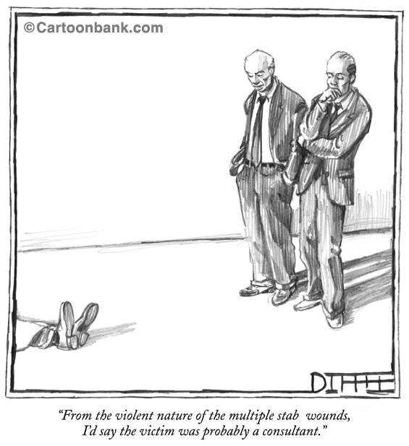
Step 7 (cont.)
Get Assistance from OQM
© 2001 The New Yorker Collection from cartoonbank.com. All Rights Reserved.

Slide 102
Step 7 (cont.)
Data Collection Plan
* Use the template(s) available to help you define your measures
  Measure Roadmap, or
  Data Collection Plan
Templates walk you through the measurement definition and collection process and specify,…..
  performance measure link to objective
  methodology used for data collection
  ownership of measure
  source of data
  frequency of data collection
  targets
* Available at http://www.nih.gov/od/ors/od/oqm/pm/index_pm.htm and described in Managing With Measures, June 2004

Slide 103
Step 8
Gather and Analyze Customer Data

Slide 104
Step 8 (cont.)
Steps in Gathering Customer Data
Steps to Gather Customer Data
  Pilot test data collection tools
  Determine dates and locations for data collection
  Publicize data collection effort (if relevant)
  Start data collection period
  Collect the data
  Provide follow-up reminders if applicable
  End data collection period
  Enter data into the appropriate IT system
  Check/transform the data as needed
  Analyze the data and product summary graphs, charts, tables

Slide 105
Step 8 (cont.)
Analyzing Customer Data
There are generally two types of data: quantitative and qualitative
Analyzing data is not simple – contact OQM for assistance
  There is both an art and a science to analyzing data
  Compare yourself over time or to others to better understand your results
  Highlight similarities and differences
  Categorize findings in a way that tells a story
  Do NOT report all the data -- be selective

Slide 106
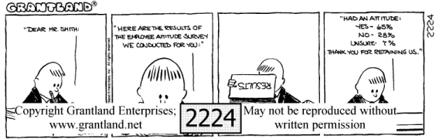
Step 8 (cont.)
Analyzing Data is a Skill

Slide 107
Step 8 (cont.)
Types of Charts and Graphs
Pie Charts
  Example 8-1
    FY04 Bioengineering and Physical Science Collaboration Needs Assessment
Bar Charts
  Example 8-2
    FY05 Support Foreign Staff Exchange Program Division of International Services (DIS) Visiting Program Participant Survey
  Example 8-3
    FY04 Office of Research Facilities Senior Leadership Survey
Line Graphs
  Example 8-4
    FY04 ORS Customer Scorecard Roll-up Results

Slide 108
Step 8 (cont.)
Types of Charts and Graphs (Cont.)
Pareto Charts
  Example 8-5
    FY04 Office of Quality Management (OQM) Performance Management Survey
Gap Analysis
  Example 8-6
    FY03 Library Translation Services Customer Scorecard

Slide 109
Step 8 (cont.)
Example 8-1: FY04 Bioengineering and Physical Science Collaboration Needs Assessment
Pie Chart: Respondent Characteristics - Tenure
N = 371

Slide 110
Step 8 (cont.)
Example 8-2: FY05 DIS Visiting Program Participant Survey
Bar Chart: Satisfaction – Reliability Frequency of Response
N = 112
Mean = 8.77
Median = 9
2%
15%
83%
Unsatisfactory
Outstanding

Slide 111
Step 8 (cont.)
Example 8-3: FY04 Office of Research Facilities Senior Leadership Survey
Bar Chart: Satisfaction With Service Areas by Organization

Slide 112
Step 8 (cont.)
Example 8-4: FY04 ORS Customer Scorecard Roll-up Results
Line Graph: Satisfaction - Mean Convenience Ratings
Outstanding
N = 13
Mean = 8.50
Median = 9.00
Unsatisfactory
* Group significantly different from mean (p < .05) ** Group significantly different from mean (p <.01)

Slide 113
Step 8 (cont.)
Example 8-5: FY04 OQM Performance Management Survey
Pareto Chart: Satisfaction - Mean Convenience Ratings
Extremely
Helpful
Not at all
Helpful

Slide 114
Step 8 (cont.)
Example 8-6: FY03 Library Translation Services Customer Scorecard
Gap Analysis: Satisfaction and Importance Ratings
Note: The Importance rating scale ranges from 1 - 10 where “1” represents Unimportant and “10” represents Important. The Satisfaction rating scale ranges from 1 - 10 where “1” represents Unsatisfactory and “10” represents Outstanding.

Slide 115
Step 8 (cont.)
Example 8-6: FY03 Library Translation Services Customer Scorecard (cont.)
Gap Analysis: Satisfaction and Importance Ratings–A Closer Look
Note: A smaller portion of the chart is shown so that the individual data points can be labeled.

Slide 116
Step 8 (cont.)
Data Over Time
Example 8-7
  FY05 Division of Facilities Planning Customer Scorecard
Example 8-8
  FY04 ORS Customer Scorecard Roll-up Results: Overall Service Group Satisfaction Means by Fiscal Year
Example 8-9
  FY04 ORS Customer Scorecard Roll-up Results: Percentage Change in Overall Customer Satisfaction

Slide 117
Step 8 (cont.)
Example 8-7: FY05 Division of Facilities Planning Customer Scorecard
Satisfaction Ratings by Fiscal Year
N = 14
N = 16
N = 15
N = 16
N = 15
N = 16
Satisfaction Dimension
N = 15
N = 16
N = 15
N = 16
N = 15
N = 16
Unsatisfactory
Outstanding
Note: There are no significant differences between the groups

Slide 118
Step 8 (cont.)
Example 8-8: FY04 ORS Customer Scorecard Rollup Results
Overall Service Group Satisfaction Means by Fiscal Year
* Group significantly different from Time 1 (p < .05) ** Group significantly different from Time 1 (p <.01)

Slide 119
Step 8 (cont.)
Example 8-9: FY04 ORS Customer Scorecard Rollup Results
Percentage Change in Overall Customer Satisfaction
% Change in Overall Customer Satisfaction Mean Rating
Appendix shows Service Group number mapping
* Significant change (p < .05) ** Significant change (p <.01)

Slide 120
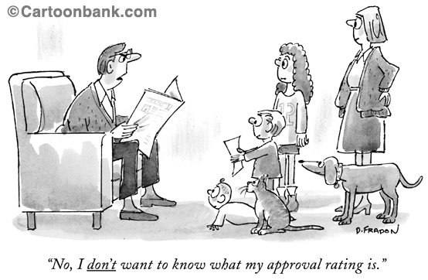
Step 9
Discuss Findings and Recommendations
© 2001 The New Yorker Collection from cartoonbank.com. All Rights Reserved.

Slide 121
Step 9
Discuss Findings and Recommendations (cont.)
Data not worth anything if not reviewed for findings and recommended actions
If issues are identified, some kind of action is imperative
  Customers share dissatisfaction and nothing happens -- organization has failed them twice
Actions can be thought of as service recovery
  Recovery can impact tremendously on satisfaction and loyalty
  In general customers have basic expectations

Slide 122
Step 9
Basic Expectations of Customers Regarding Service
Customer Expectations
  Be competent
  Explain things
  Be respectful
  Keep me informed
  Be on my side
  Play fair
  Protect me from catastrophe
  Keep your promise
  Fulfill obligations
  Learn my business and work with me
  Share my sense of urgency
  Be competent
  Be prepared
  Be flexible
Source: Parasuraman, Berry, & Zeithaml, 1991.

Slide 123
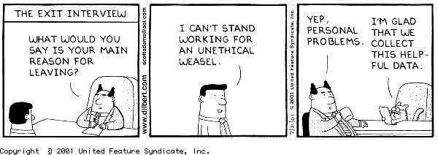
Step 9
Interpreting Findings

Slide 124
Step 9
Tips for Interpreting Data
Try to see the forest through the trees
Organize your data and findings to tell a story
Get front-line employee involved
Involve customers if they are willing
Organize findings to report both good news and areas for improvement
Develop a presentation summarizing the measurement process, method, findings, and recommendations

Slide 125
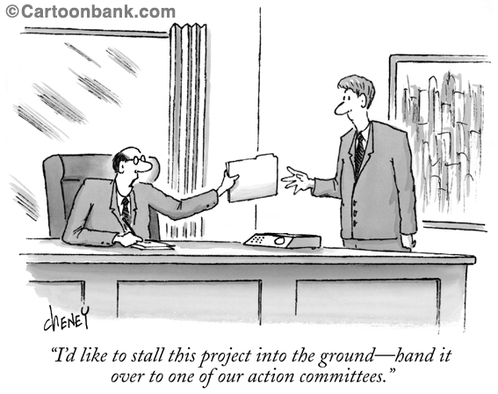
Step 10
Take Action
© 2001 The New Yorker Collection from cartoonbank.com. All Rights Reserved.

Slide 126
Step 10
Take Action (Cont.)
Taking action is the bottom line
If nothing else -- you must provide feedback to customers on findings
  Won’t cooperate with future data collection
  May negatively impact on their image of you
Balanced Scorecard approach encourages integrating customer data into strategic planning process
  Customer data is KEY ingredient in way the organization does business
  Customer data should DRIVE organizational improvement
Remember that improvement is a process
  Outstanding service doesn’t come over night
  It’s not impossible
  Just takes commitment to customer satisfaction and quality

Slide 127
Conclusion
Customer Assessment is essential to measuring the impact of your strategy
  Meant to be used in conjunction with the other perspectives of your PMP
The 10 steps are a guideline to get you started
Customer data helps you answer the question, “How well do I deliver on my “value proposition”?

