Slide 1
DQMP
For Application
Approvers
&
Requestors
Prepared by MJ Lee

Slide 2
COMM IT Alert
DQMP
The DQMP is a Power Platform application solution developed for DQMP to streamline and automatize the process of document approval within NIH community.
This application facilitates the process from creating, tracking and managing the requests for Requestors to streamlining the approval process for approvers who take an approval action utilizing a Power App and Power Automates.
This manual is prepared for the approvers who participate in the approval process of the requests, the Requestors who create, submit and track the status, and admins who overseas the process.
The DQMP solution is composed of two sections as follows:
Power App: Dashboard for Requestors, approvers and the Admin to create, submit, approve, and track the status.
Power Automate: The approval process, notifications to approvers and the Requestors via Teams, Outlook and Power Automate linked from Outlook.

Slide 3
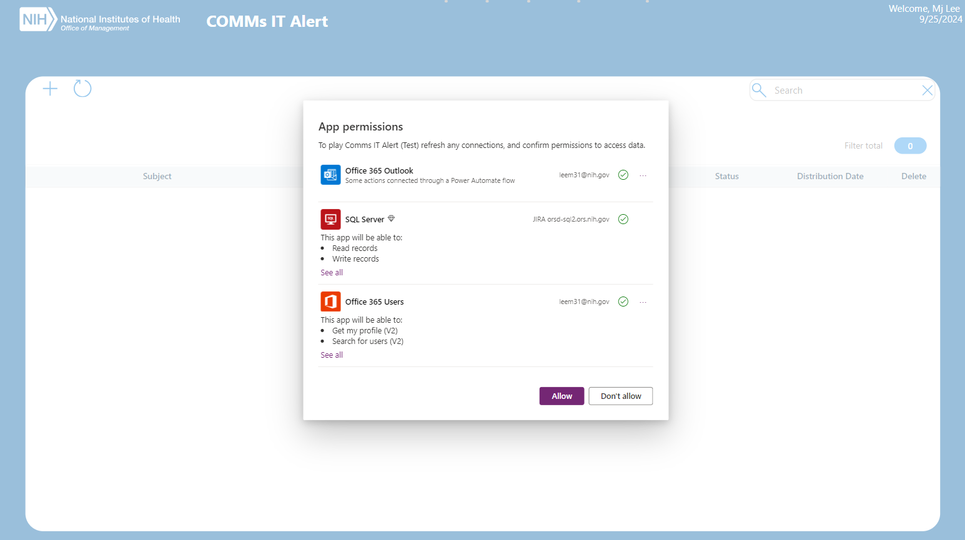
DQMP
User Logon Prompt
DQMP Power App
When users log on to the Power App, they get prompted to allow permission to connection. Click Allow button to proceed.

Slide 4
COMM IT Alert
Requestor
DQMP Power App
Request and gain access to Power App by contacting DQMP admins at DQMPSTAFF@mail.nih.gov or Peter Whitesell at peter.whitesell@nih.gov.
Ensure not to include special characters in the file name as attachments
Submit requests via Power App
Track the status of submitted requests on the dashboard
If the request gets rejected or approved by the final approver, an email notification will be sent out to the Requestor.
The Power Automate run duration of the workflow process for a submitted request is 28 days before it gets automatically canceled after it times out.

Slide 5
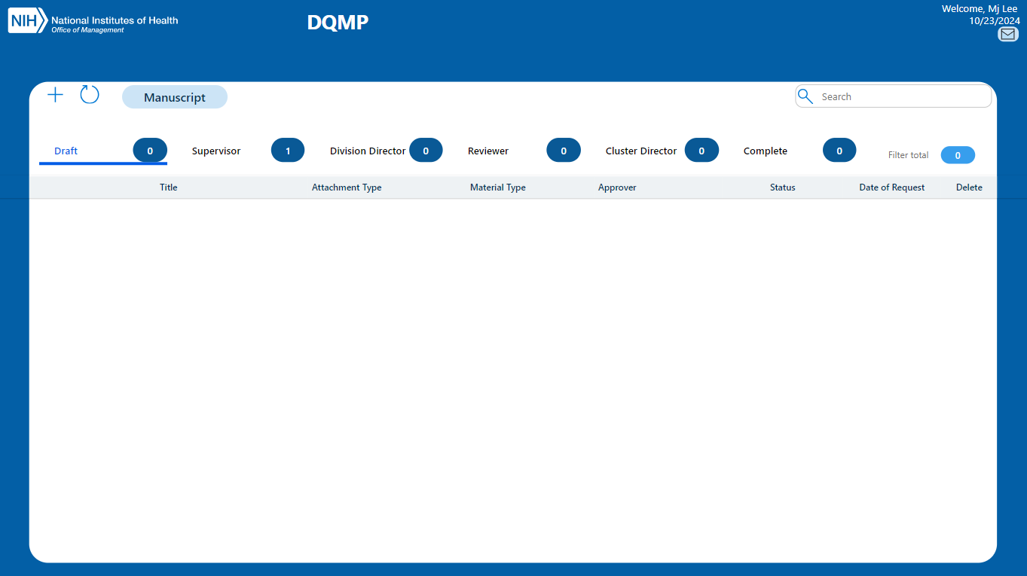
1. Requestor Overview of Dashboard
Email to Admin
Refresh
New
Manuscript/Presentation Toggle
Search
Status button
Filter total
Status total

Slide 6
2. Requestor - Create Requests
Requestor logs onto the dashboard in Power App.
Click New icon to create a new request.
New

Slide 7
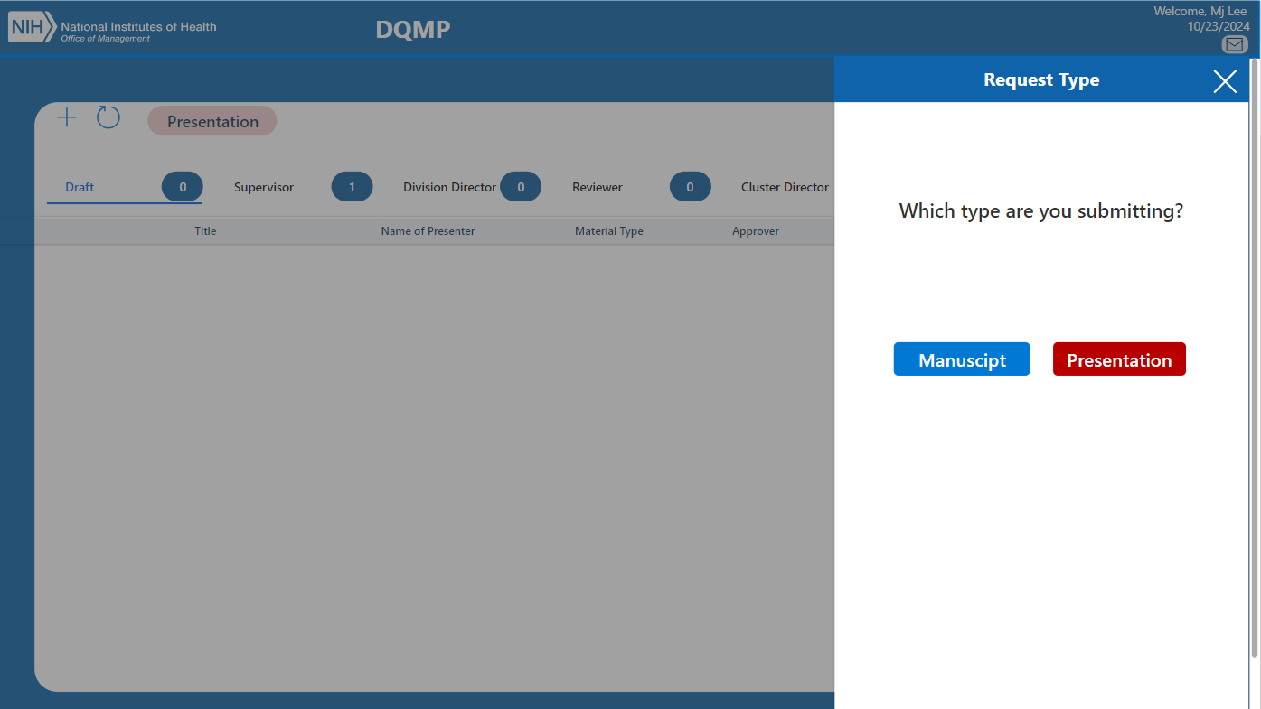
2. Requestor - Create Requests
When prompted, select the request type to submit.
Request type options

Slide 8
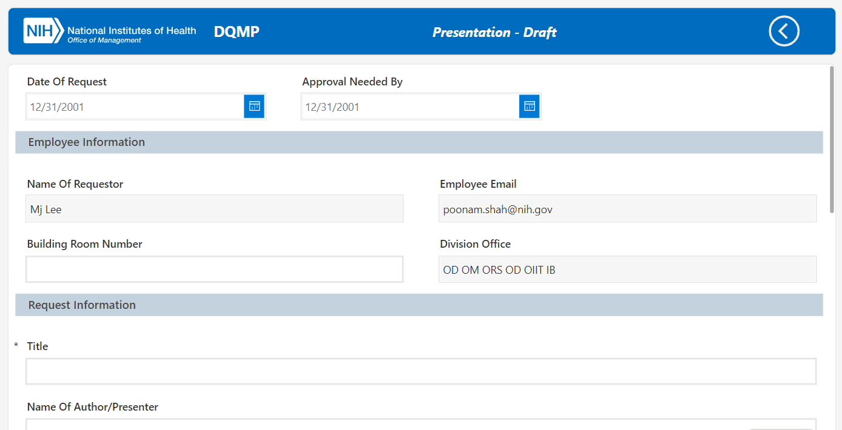
3. Requestor New Form –Presentation, part1
Requestor fills out the new form to submit.
Fill out the date information.
The employee information gets auto-populated at logon. Fill out the building and room number.
The Title field is required for submission.
Request Dates
Auto-populated employee info
Required field

Slide 9
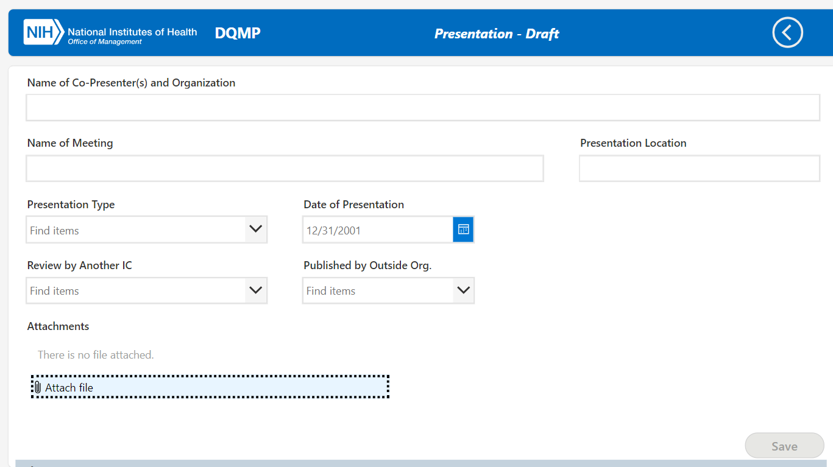
4. Requestor New Form –Presentation, part2
After filling out the rest of the presentation information, click attach file icon to attach documents.
Attach file here

Slide 10
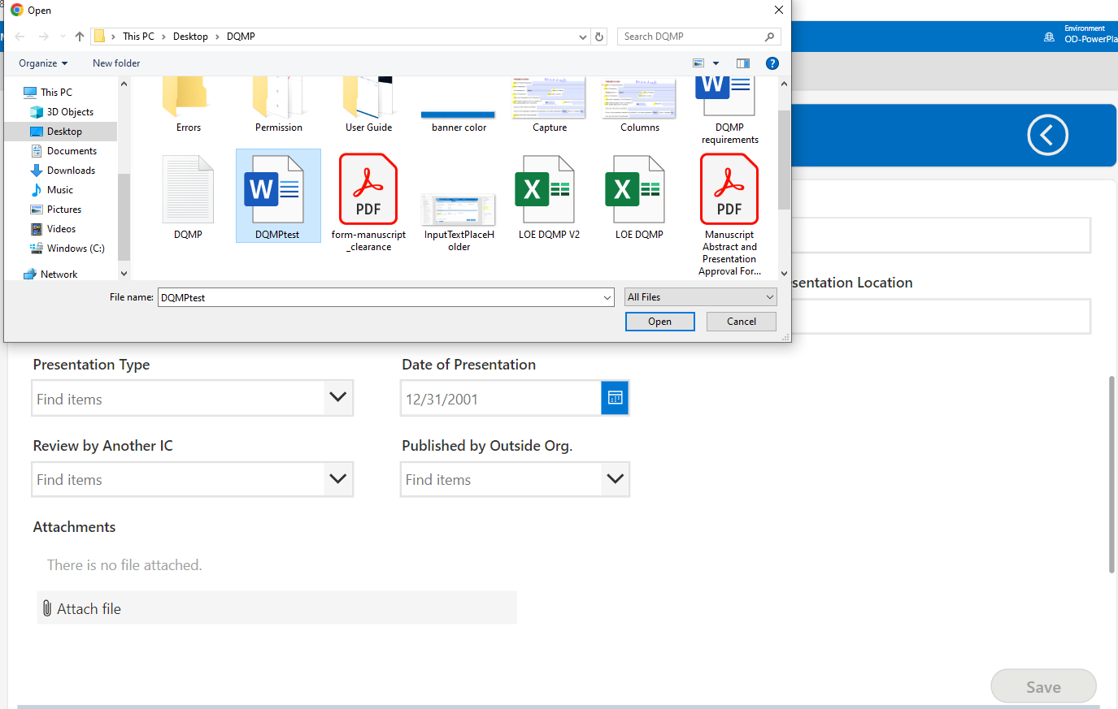
5. Requestor New Form –Presentation, part3
Select a document(s) and click the “Open” button to attach.
Click to attach selected file.
Attach file here

Slide 11
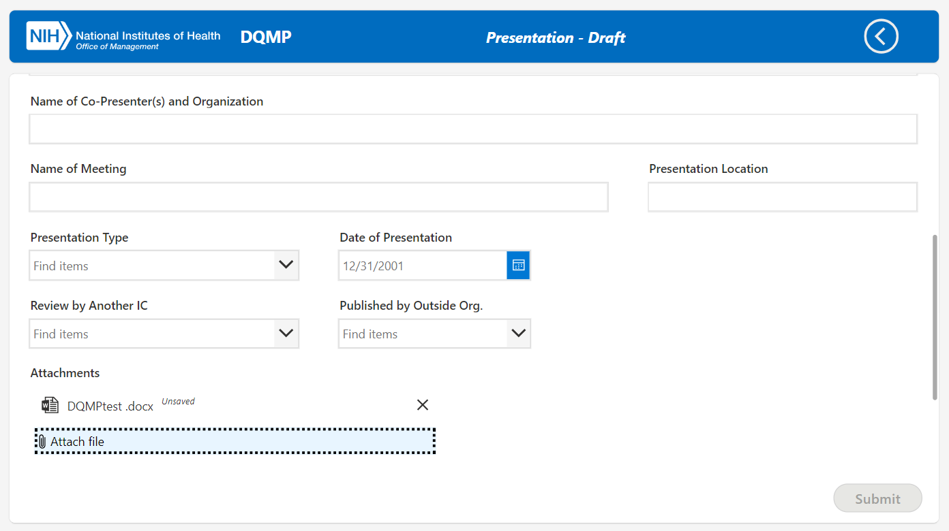
6. Requestor New Form –Presentation, part4
Once attached, the file name is displayed. It can be removed by clicking the x icon if needed.
The file size limit is 50 megabytes per attachment and the max number of attachment is 6.
View attached file with delete option.

Slide 12
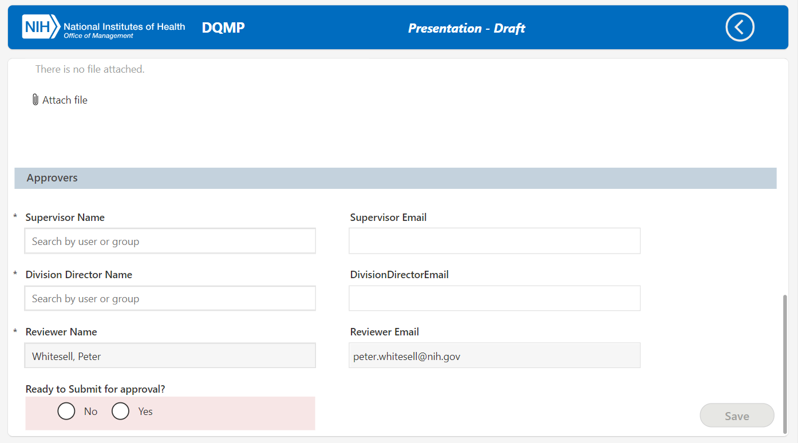
7. Requestor New Form –Presentation, part5
Approvers information is required for submission.
The reviewer is set as Peter Whitesell by default.
The supervisor and division director information can be searched by user name or group in the active directory.
Required fields for submission

Slide 13
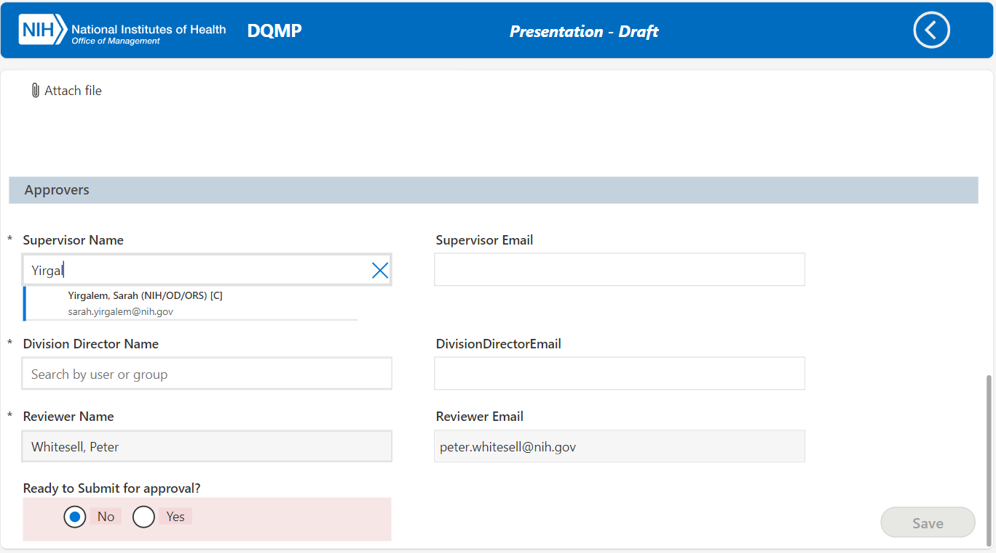
8. Requestor New Form –Presentation, part6
Type Last name, first name format in the name field for user gallery to show.
Select appropriate supervisor and division director, which auto-populates the email addresses.
Select an approver from the user gallery

Slide 14
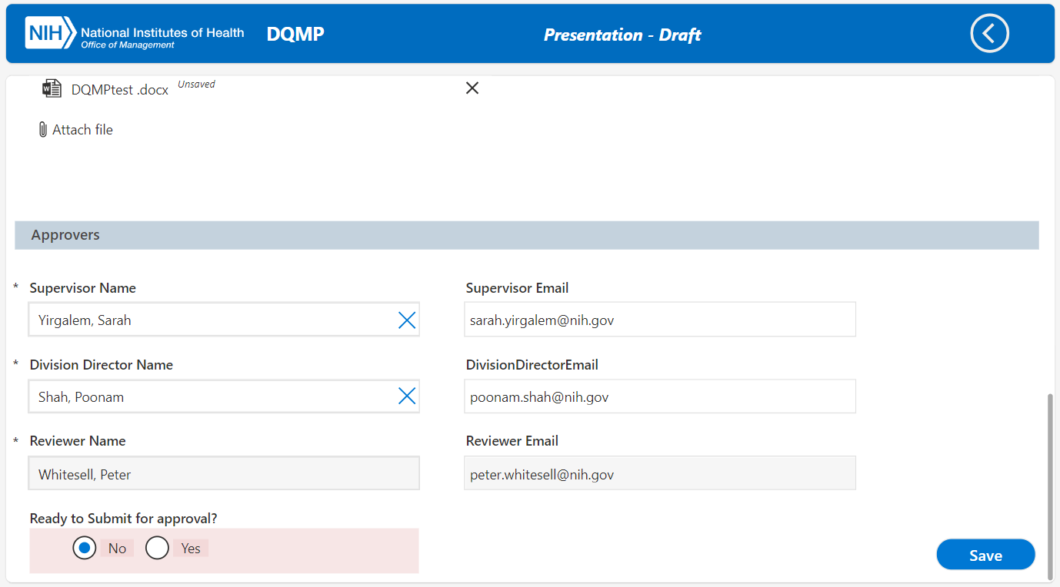
9. Requestor New Form –Presentation, part7
When all the required fields are entered, the save button gets enabled to save and submit later.
Enabled to save when all the required fields are entered.

Slide 15
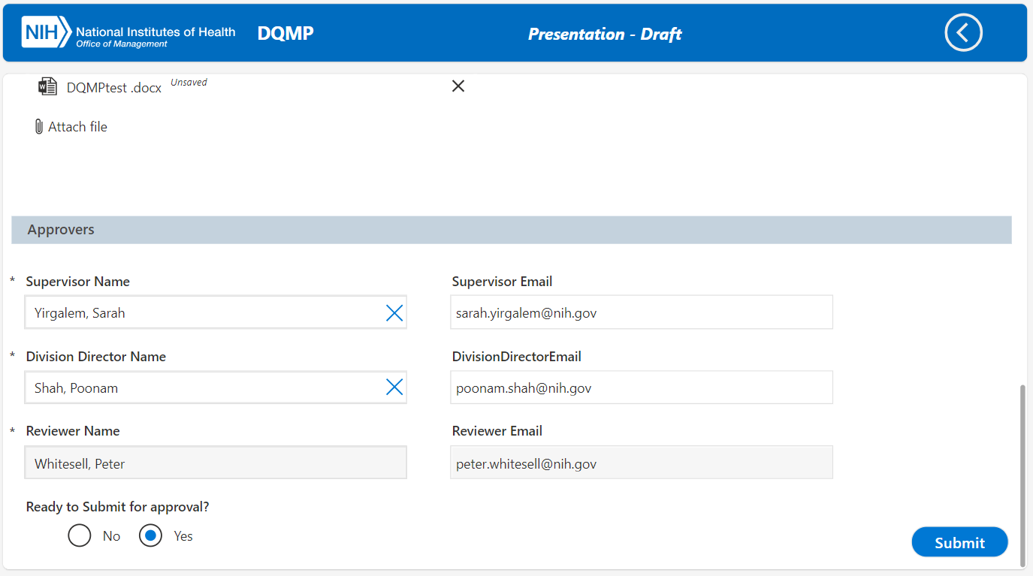
10. Requestor New Form –Presentation, part8
When ready to submit for approval is selected to “Yes”, the form can be submitted.

Slide 16
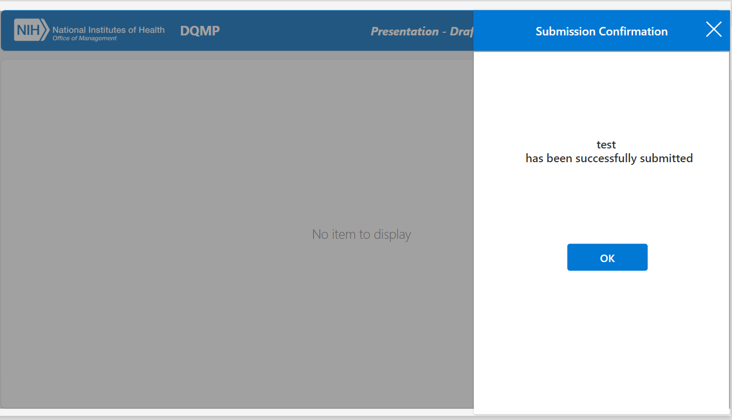
11. Requestor New Form –Presentation, part2
Once submitted, the requestor gets prompted with a submit confirmation with the title of the submitted request.
Click OK to return to the dashboard.

Slide 17
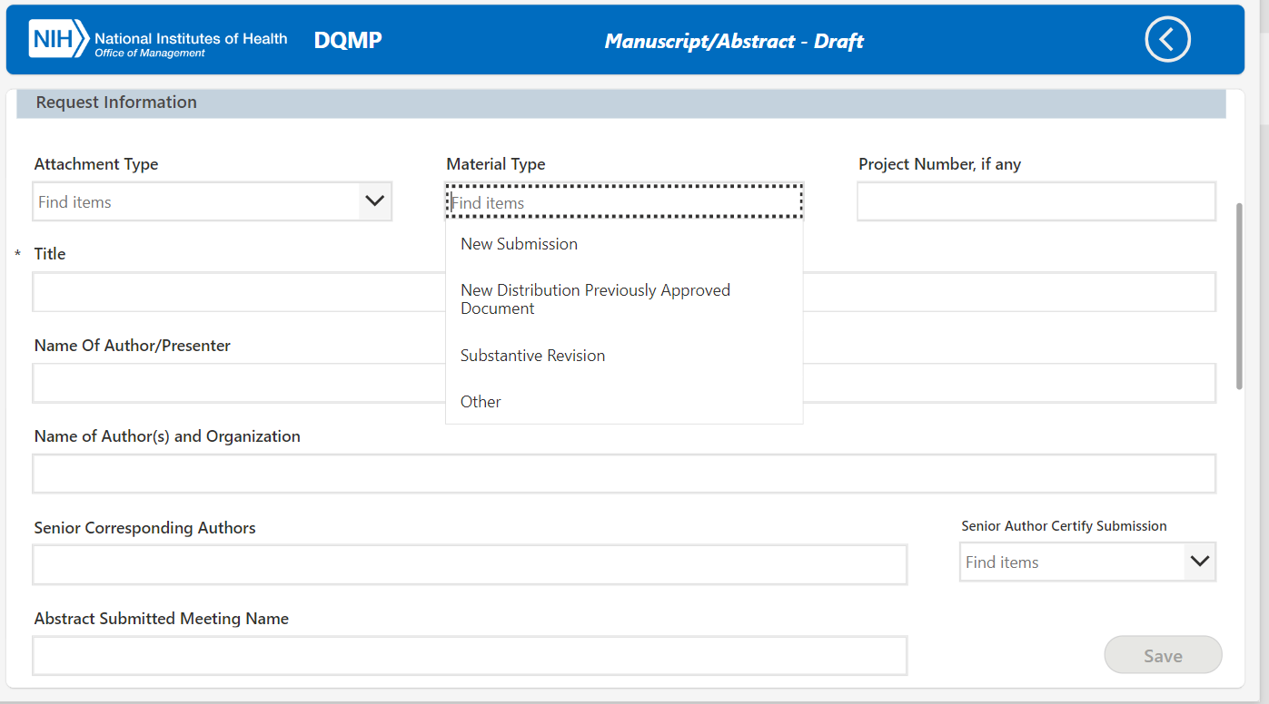
12. Requestor New Form –Manuscript, part1
The required fields for submission is the same as the Presentation type.
When Substantive revision is selected as material type, cluster director approval is required.

Slide 18
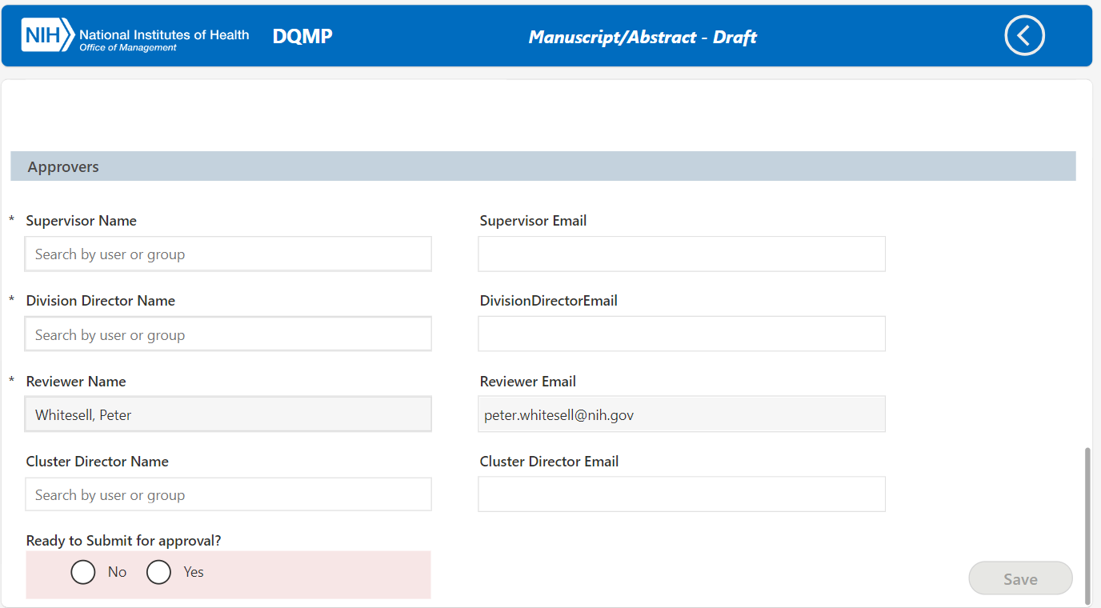
13. Requestor New Form –Presentation, part2
Approvers’ information is required for submission along with the additional cluster director.
Required fields for submission

Slide 19
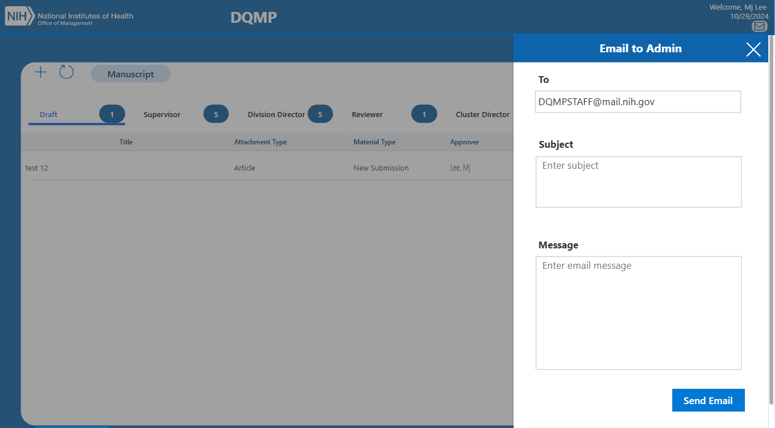
14. Requestor –Contact Admins
Click the email icon to send a message to DQMP admins.
Fill out the subject and the message.
Click the send email button to complete.
Required fields for submission

Slide 20
COMM IT Alert
Approvers
DQMP Power App
Approve requests via Teams or Power Automate linked from Outlook email
Either Approve or reject the request with an option to add comments.
The request form in Power App can be accessed via the request link in the approval notification of the Teams or Outlook
The form is for view only and the browser needs to be closed after review.
The approval dashboard is looks the same for all approvers except for admins.
The Power Automate run duration of the workflow process for a submitted request is 28 days before it gets automatically canceled after it times out.

Slide 21
COMM IT Alert
Supervisor
DQMP Power App
When a request is submitted and its status gets updated from Draft to Pending Supervisor, take an approval action via Teams or Power Automate linked from Outlook email
Either Approve or reject the request with an option to add comments.
The Power Automate run duration of the workflow process for a submitted request is 28 days before it gets automatically canceled after it times out.

Slide 22
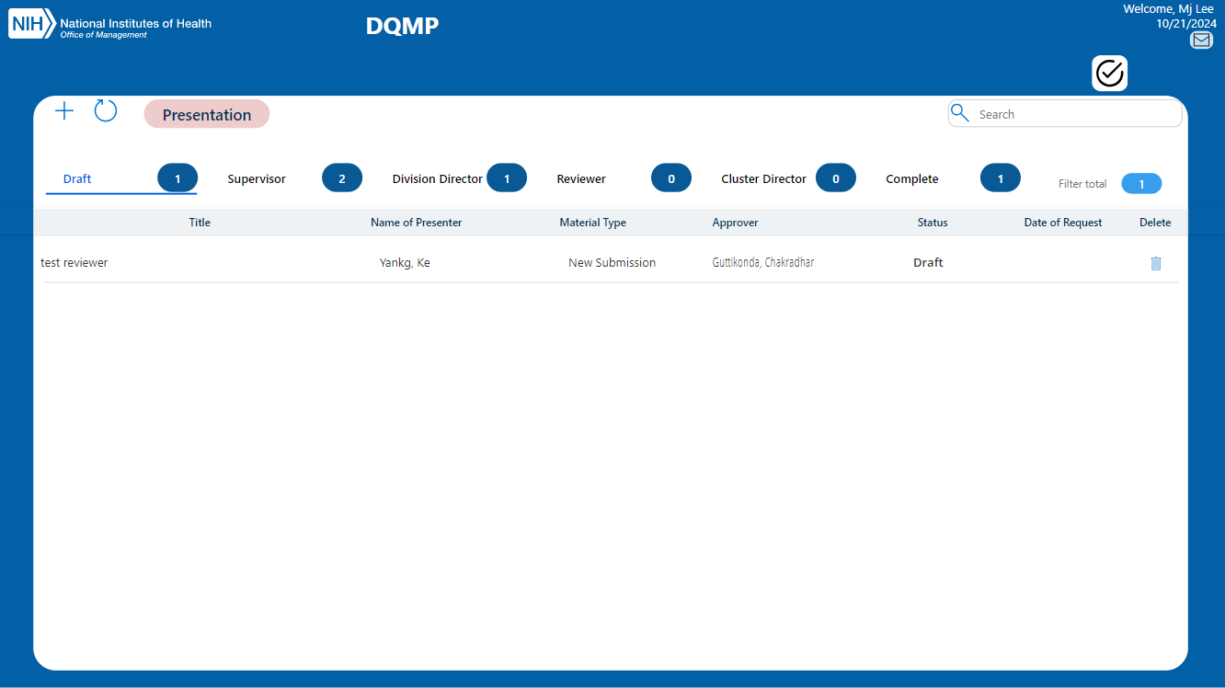
1. Supervisor Overview of Dashboard
Approval
Email to Admin
Refresh
New
Manuscript/Presentation Toggle
Search
Status button
Filter total
Status total

Slide 23
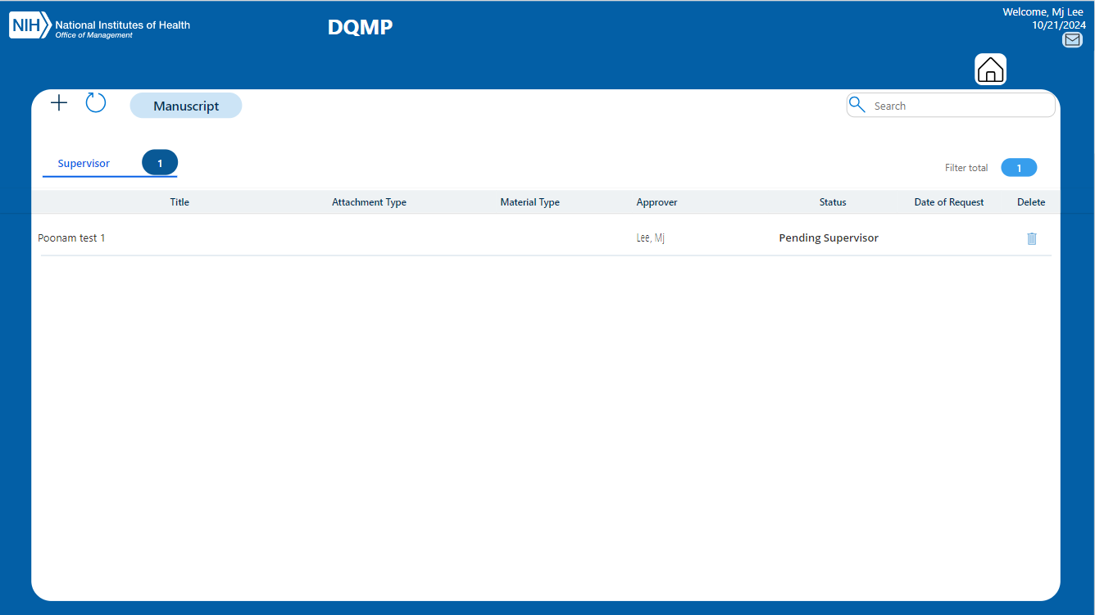
2. Supervisor Approval Dashboard
Click the My Approval icon to view the pending supervisor approval requests.
Click on the request to view the request form.
The “Home Icon” navigates back to the dashboard.

Slide 24
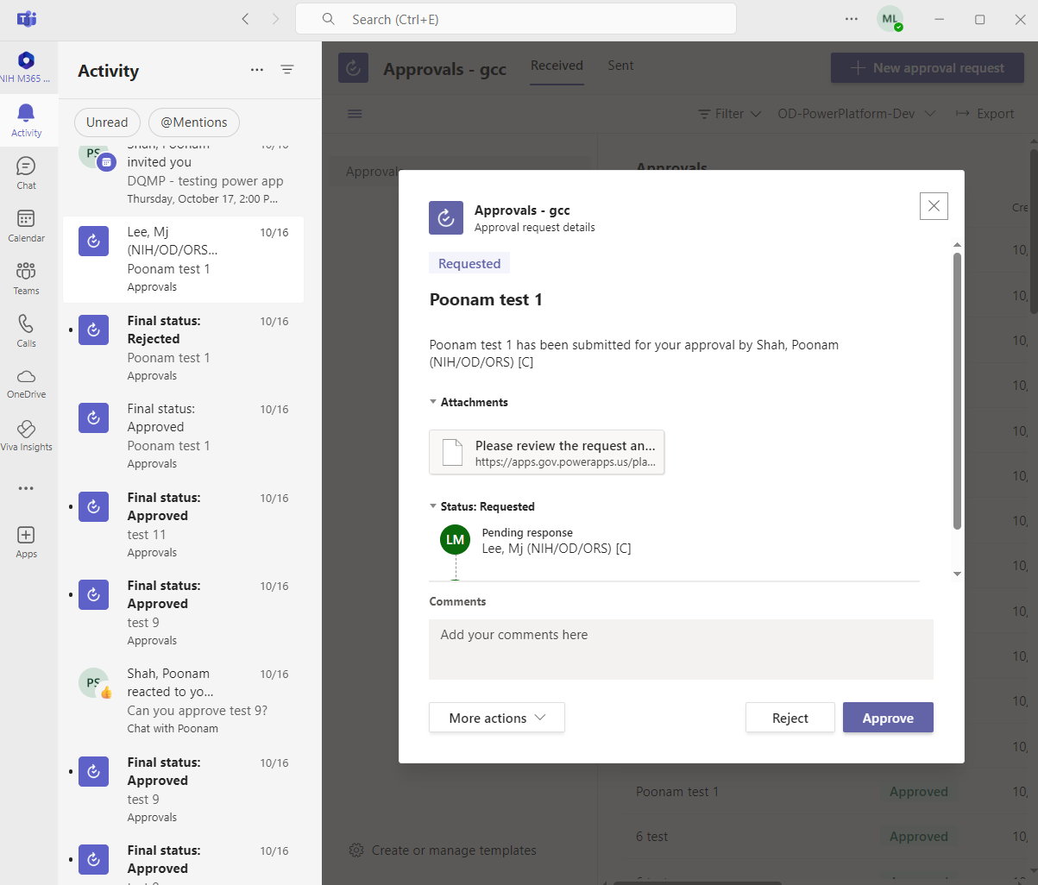
3. Supervisor Approval - Teams notification
A notification via Teams is sent to Primary Reviewer when the Power Automate is triggered by clicking the “Submit Review” button.
There are 6 parts in the Teams notification:
Approval content including title and important information
Attachments contains an item link which links to the item on the Power App
Approval status with approver and date and time info
Comments for approval
More actions such as cancel or reassign the approval task to another user
Approval response buttons for approve or reject
Approval content
Attachments for item link
Status
Commentss
More actions
Approval buttons

Slide 25
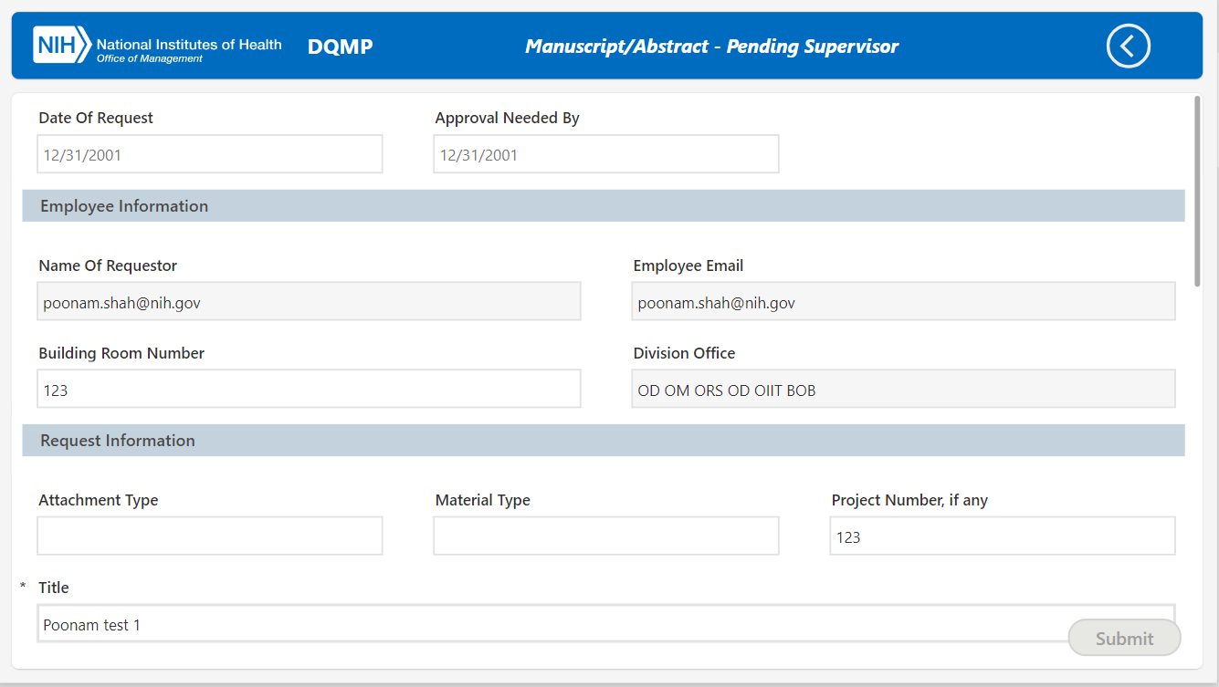
4. Supervisor Form view in Power App from link Teams
Approval status
When a request attachment or link is clicked, reviewers can view the item in detail as well as take approval action on the Power App – part 1.

Slide 26
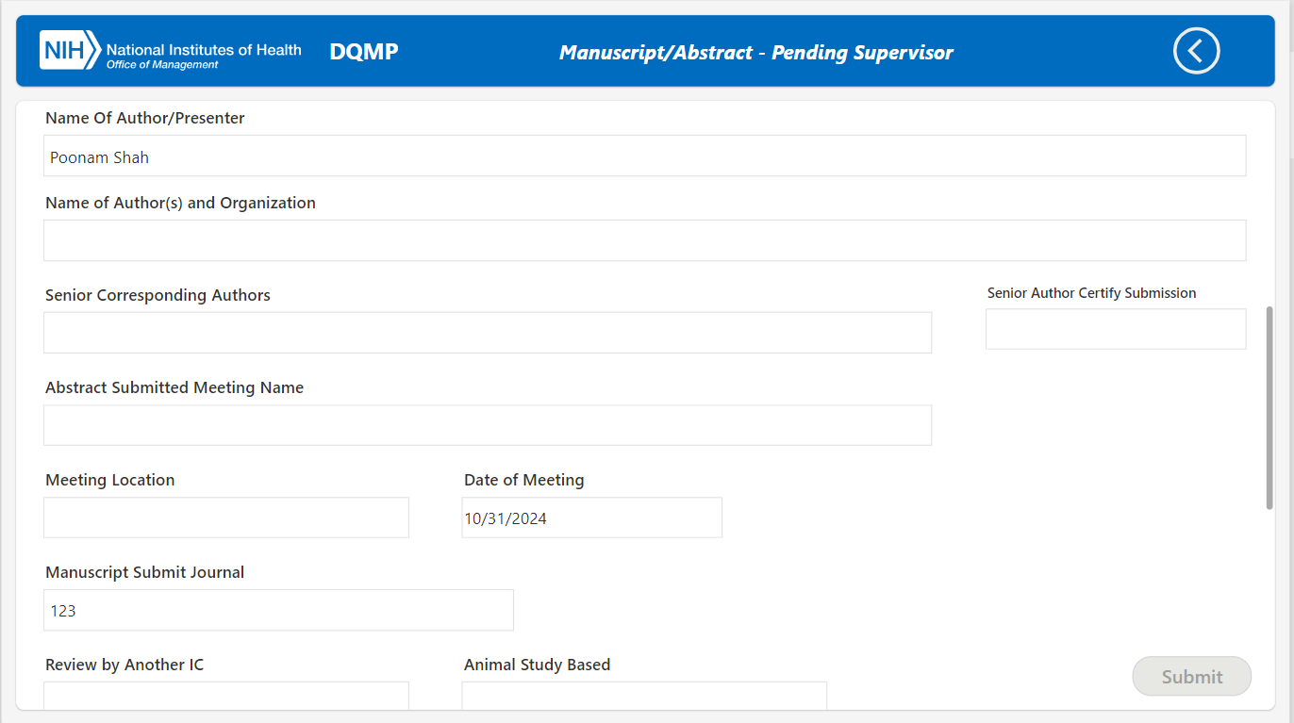
5. Supervisor Approval via Power App from request link
Approval status
Part 2.

Slide 27
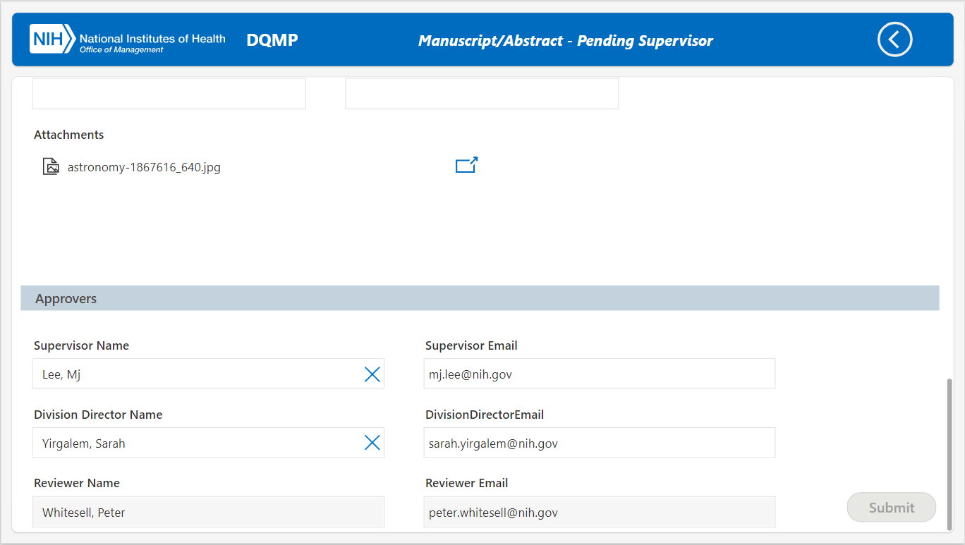
6. Supervisor Approval via Power App from request link
Approval status
Part 3.

Slide 28
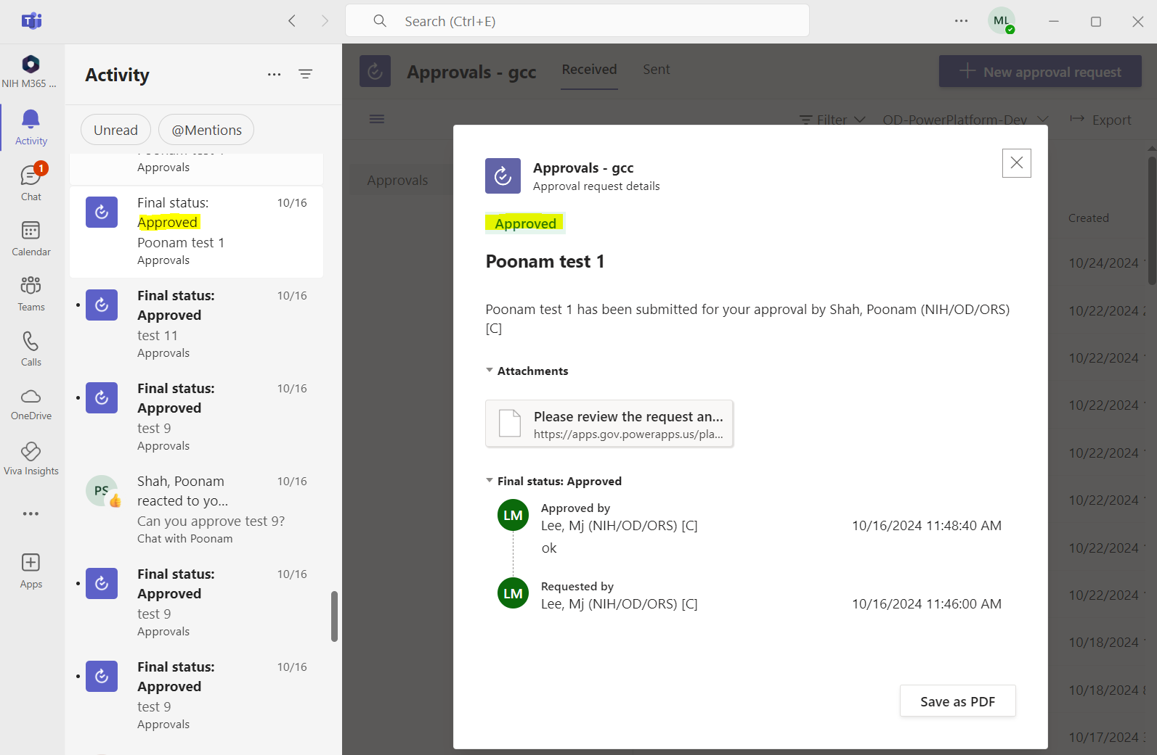
7. Supervisor Approval - Teams notification
An expanded status responded and more actions dropdown options within Teams notification.
Status
More actions

Slide 29
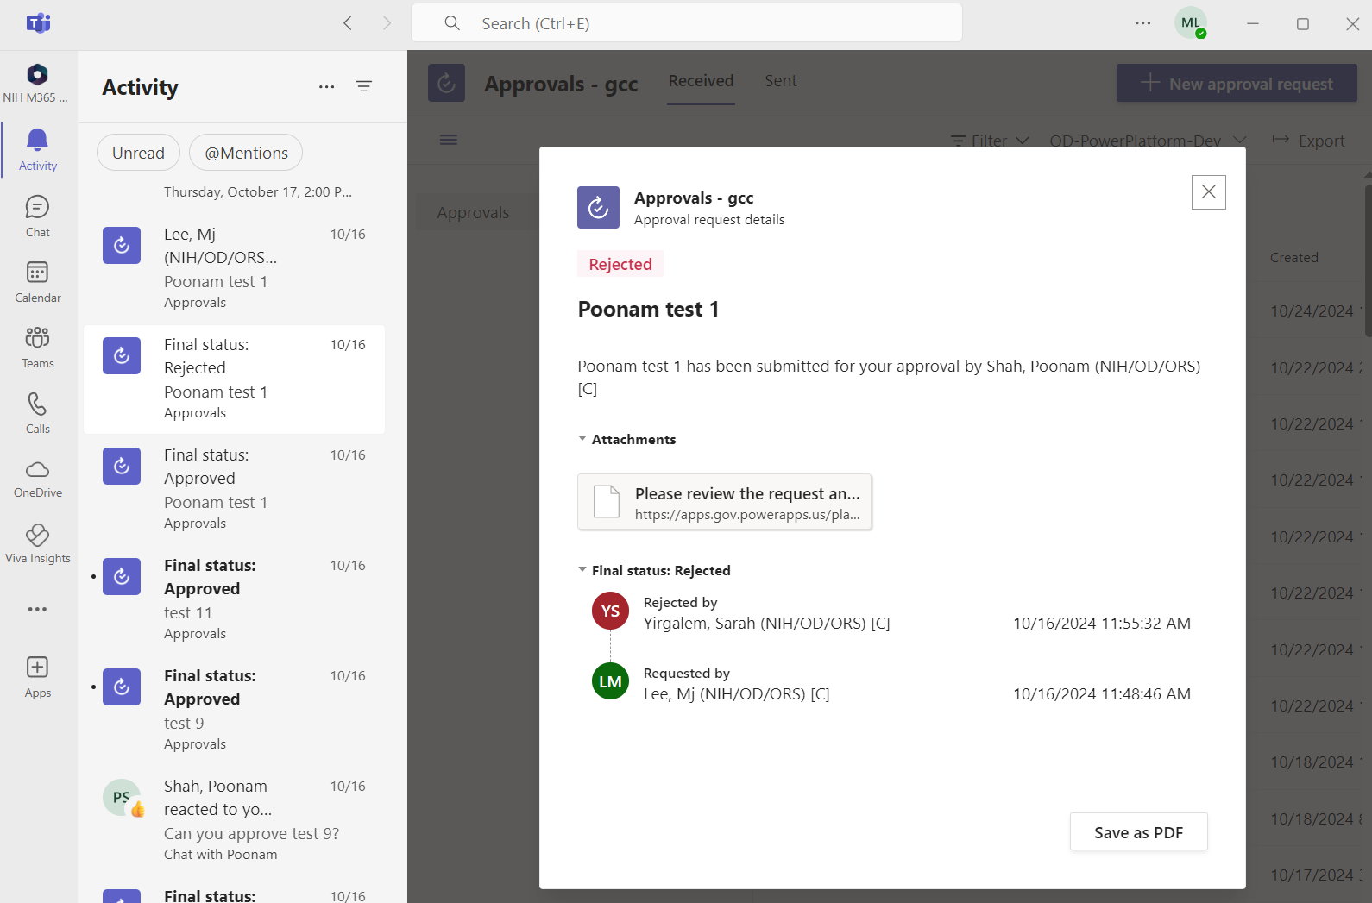
8. Supervisor Approval - Teams notification Cancelled
A Cancelled approval within Teams notification.

Slide 30
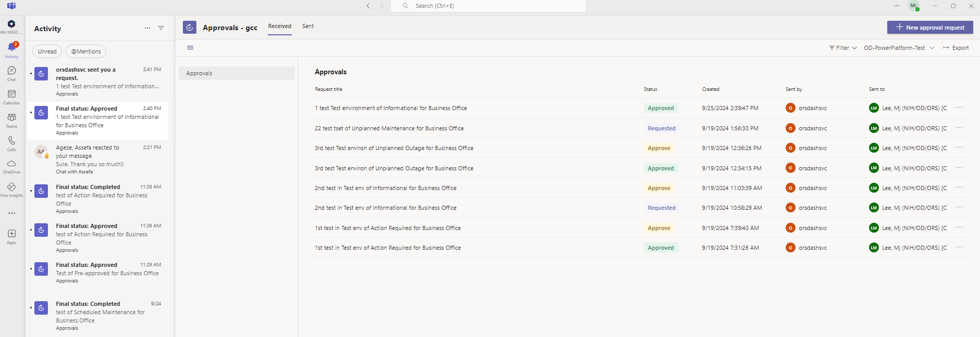
9. Supervisor Approval - Teams Approval Activity Dashboard
Approvers can view the approval activities on the dashboard on Teams.

Slide 31
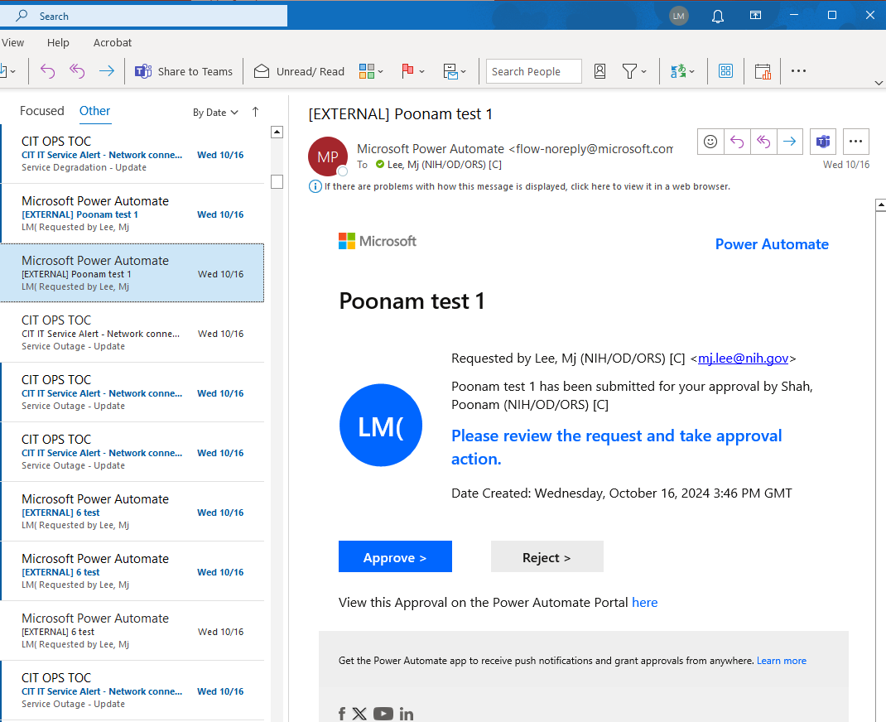
10. Supervisor Approval - Outlook notification
Outlook notification is also sent to supervisor when the Power Automate is triggered by submitting the request.
There are 3 parts in the Teams notification:
Approval content including title and important information
Description of an item link which links to the item in the Power App
Approval response buttons that opens an approval dashboard in Power Automate
Approval content
Request link
Approval buttons

Slide 32
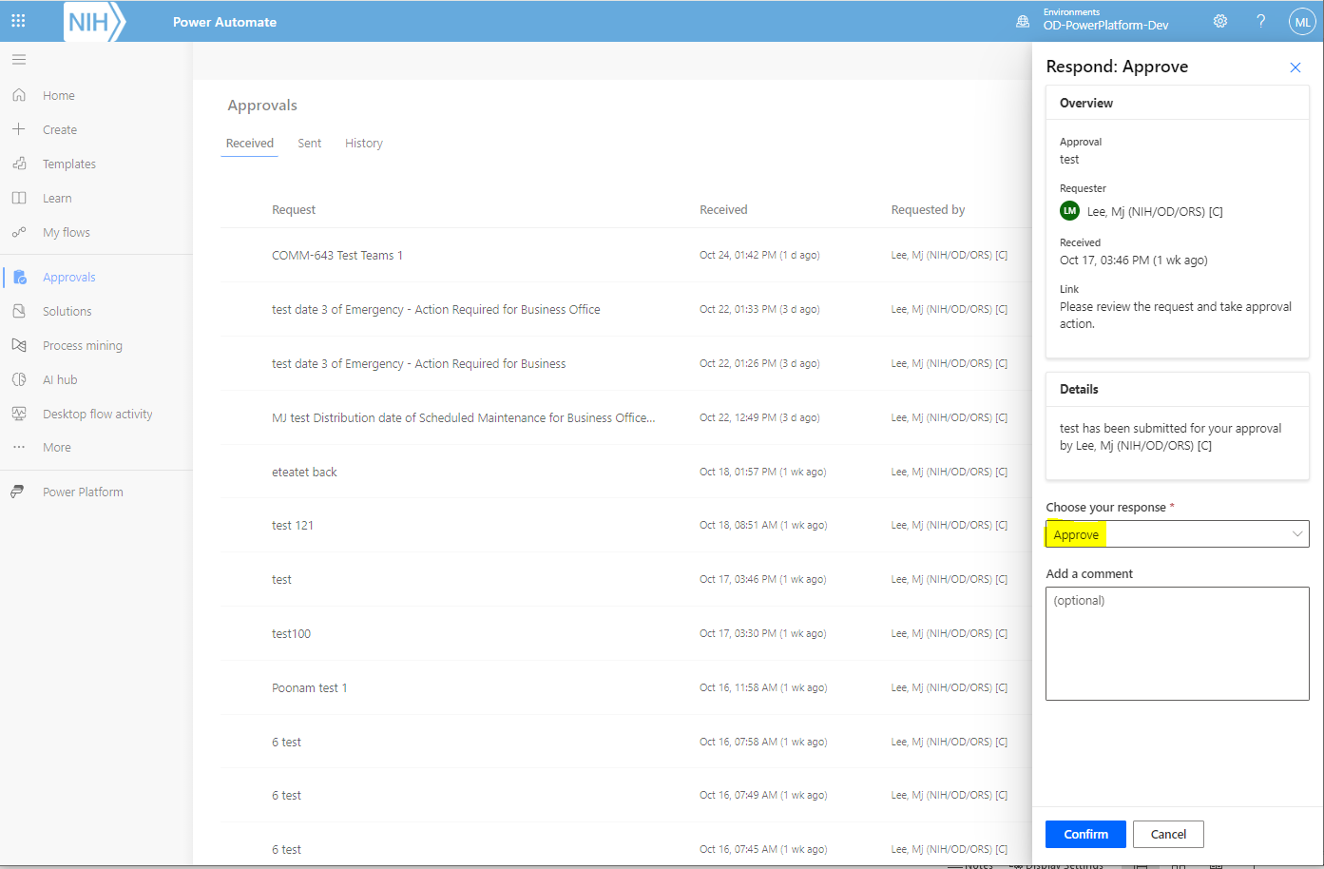
11. Supervisor - Cancelled Approval on Power Automate
When an approval link a request is opened, the selected approval button value in Outlook is already selected on the approval panel of the Power Automate.
Select the approval option.
Click the confirm button to send the approval response.
Approval options
Approval buttons

Slide 33
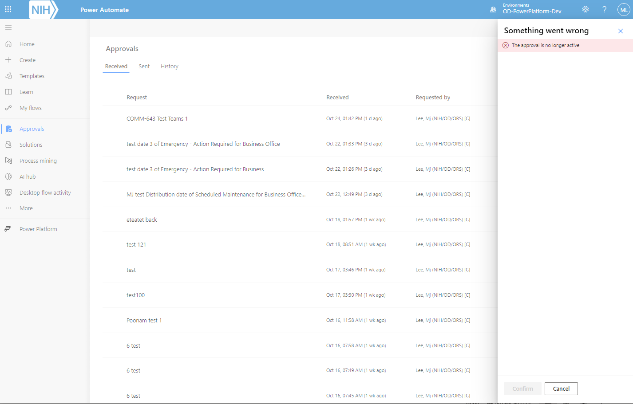
12. Supervisor - Cancelled Approval on Power Automate
When an approval link a request is opened and an approval action had been already taken or cancelled, “The approval is no long active” message is displayed on the approval dashboard in Power Automate.

Slide 34
COMM IT Alert
Division Director
DQMP Power App
Approve requests via Teams or Power Automate linked from Outlook email
Either Approve or reject the request with an option to add comments.
The Power Automate run duration of the workflow process for a submitted request is 28 days before it gets automatically canceled after it times out.

Slide 35
1. Division Director
Overview of Dashboard
Approval
Email to Admin
Refresh
New
Manuscript/Presentation Toggle
Search
Status button
Filter total
Status total

Slide 36
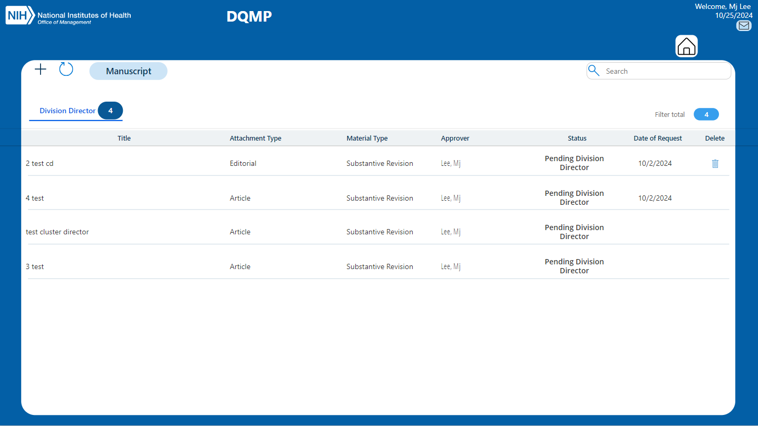
2. Division Director Approval Dashboard
Click the My Approval icon to view the pending Division Director
approval requests.
Click on the request to view the request form.
The “Home Icon” navigates back to the dashboard.

Slide 37
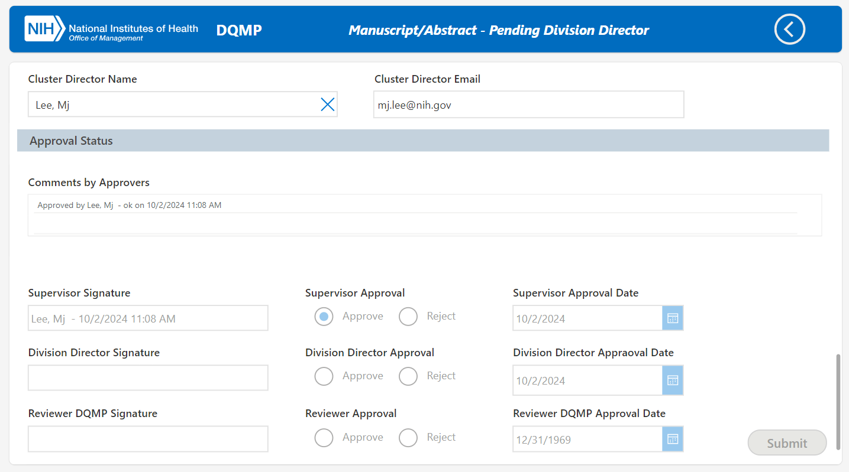
3. Division Director Approval via Power App from request link
The supervisor signature has been updated and it is waiting for division director’s approval.– part 4.

Slide 38
COMM IT Alert
Supervisor & Division Director
DQMP Power App
Reviewers who are also designated as a Supervisor and Division Director can view the requests that they have been assigned as a sender of a branch and submit requests for manual distribution.

Slide 39
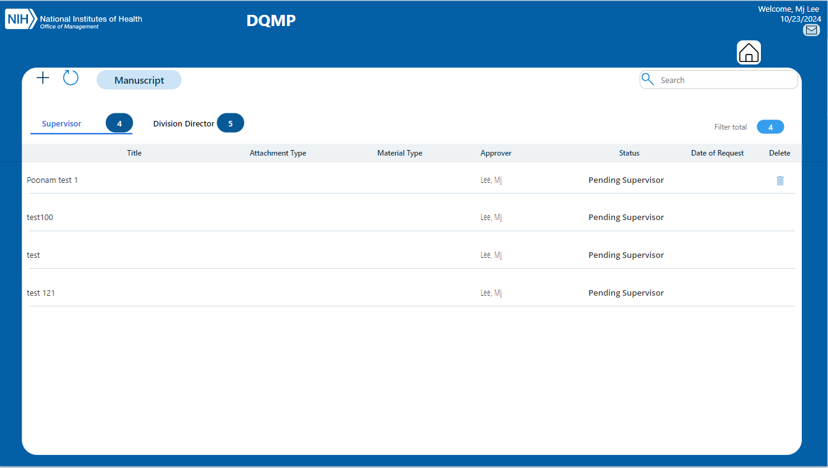
1. Supervisor/Division Director Dashboard
Back to Dashboard
Approver who perform as a sender can view the requests that they have been assigned as a sender by toggling the sender icon.
To exit the sender’s view toggle the sender icon.
Approval Status

Slide 40
COMM IT Alert
Reviewer & Admin
DQMP Power App
Approve requests at the Pending Reviewer status.
Oversea and track all the submission and their status.
The approval responses via Teams is faster than through the Power Automate to moves to the next approval phase.
Manage user access to the DQMP Power App and the SharePoint list.

Slide 41
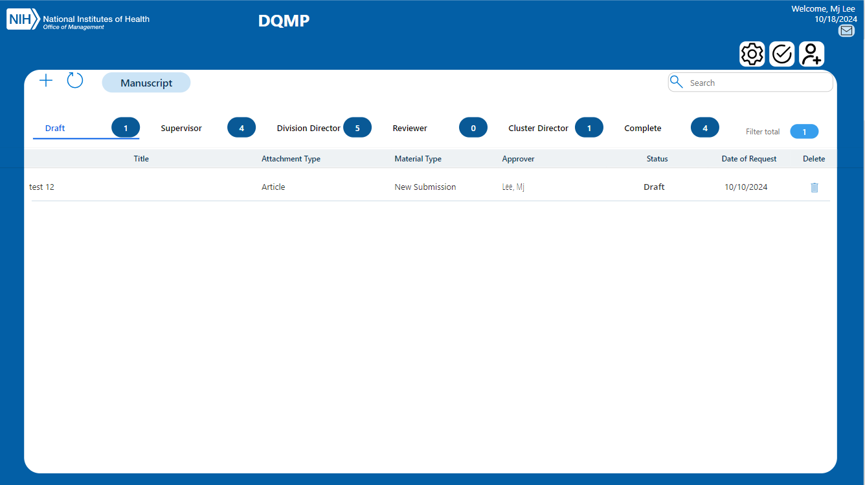
Reviewer/Admin
Overview of Dashboard
Admin icons
Email to Admin
Refresh
New
Manuscript/Presentation Toggle
Search
Status button
Filter total
Status total

Slide 42
2. Reviewer/Admin Dashboard
Admin settings allows admin to view and track all the requests.
Reviewer can view and take an approval action by clicking the approval action icon.
Admin Settings
Approval action
User management

Slide 43
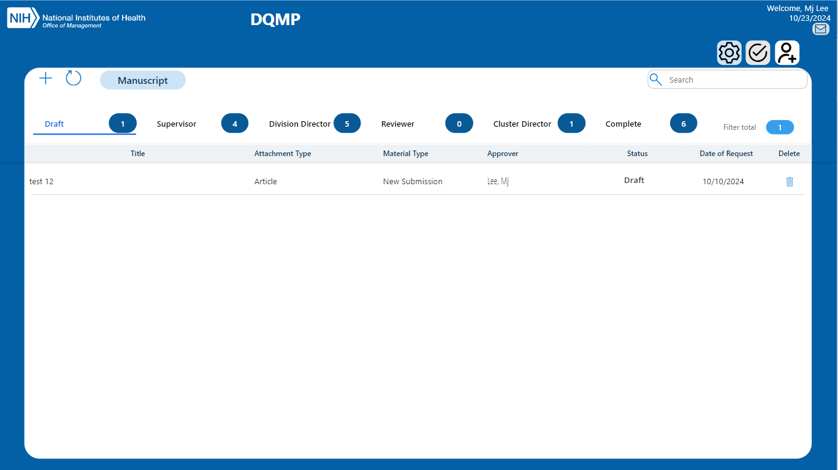
3. Reviewer/Admin Dashboard
When the admin settings icon is clicked, the approval icon is disabled.
Toggle the admin settings icon to deactivate it.
Active admin settings
Disabled Approval

Slide 44
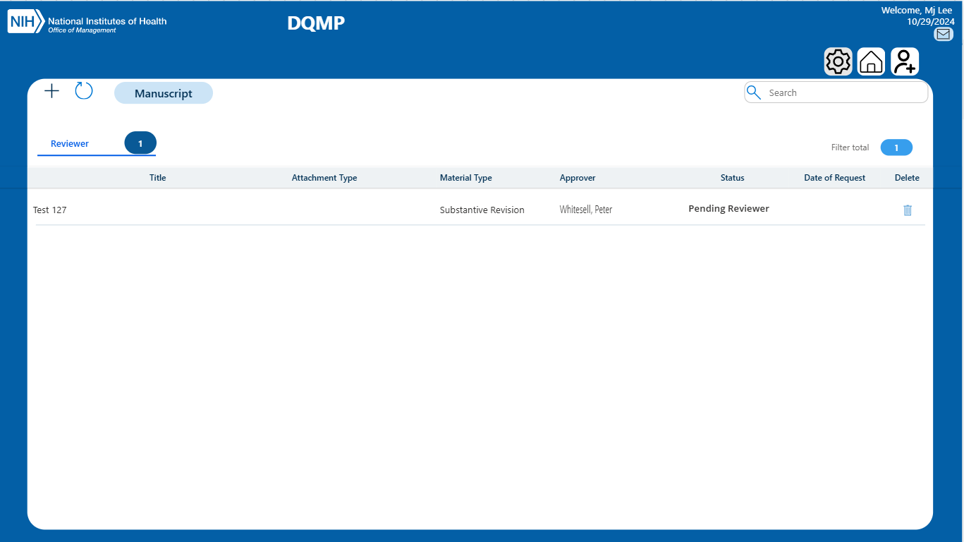
4. Reviewer/Admin Dashboard
If there are requests that are at Pending Reviewer status, they are visible in the gallery. Reviewers can click on the request to navigate to the form to view the request.
The “Home Icon” navigates back to the dashboard.
Disabled admin settings
Home
View in the form

Slide 45
5. Reviewer/Admin Dashboard
Click the user management icon to open the user management dashboard.
Admin Settings
Approval action
User management

Slide 46
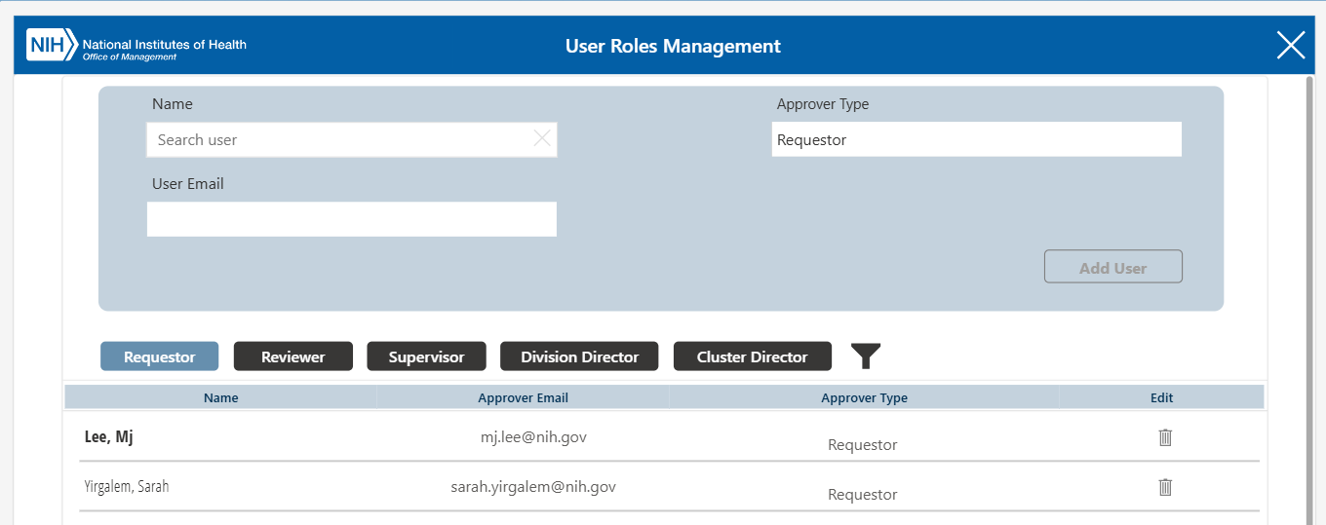
6. Reviewer/Admin User management Dashboard
Add Requestor
Admin only need to add users as requestor to grant access to the DQMP Power App.
The permission for approvers, supervisor, division director, and cluster director will be automatically granted via Power Automate when a requestor enter their information in the form and submit the request.
Filter by Roles
Current Roles
Delete

Slide 47
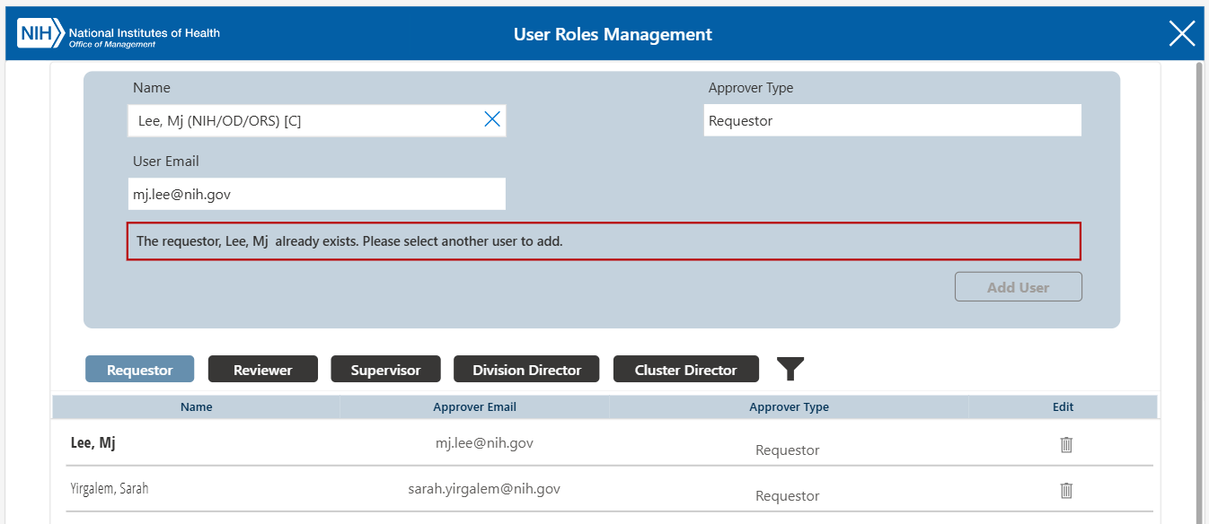
7. Reviewer/Admin User management Dashboard
Close User Management Panel
A warning that there is already an existing requestor role displays when selecting another user for the same role to prevent duplicate entry.
Duplicate Role Warning
Existing User

Slide 48
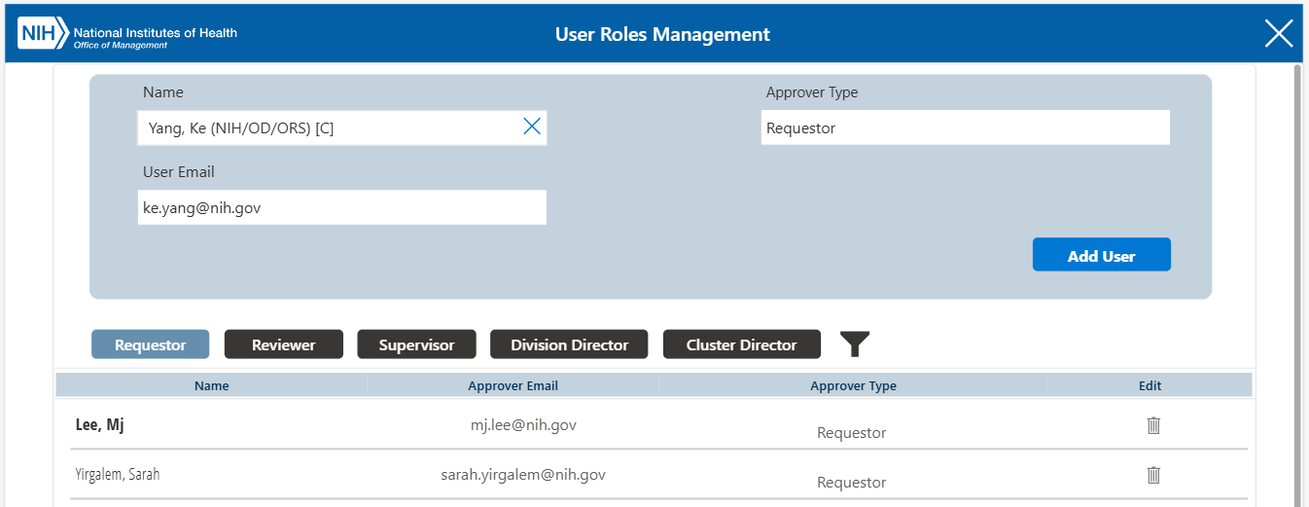
8. Admin Filter User Roles
User roles get filtered by clicking the role buttons. The filled filter icon indicates that filter has been applied.
Filter can be removed by clicking the filter icon.
Add Requestor
Filtered Role
Filter Indicator

Slide 49
COMM IT Alert
Cluster Director
DQMP Power App
Approve manuscript/abstract requests with material type of substantive revision via Teams or Power Automate linked from Outlook email.
Either Approve or reject the request with an option to add comments.
The Power Automate run duration of the workflow process for a submitted request is 28 days before it gets automatically canceled after it times out.

Slide 50
1. Cluster director Overview of Dashboard
Approval
Email to Admin
Refresh
New
Manuscript/Presentation Toggle
Search
Status button
Filter total
Status total

Slide 51
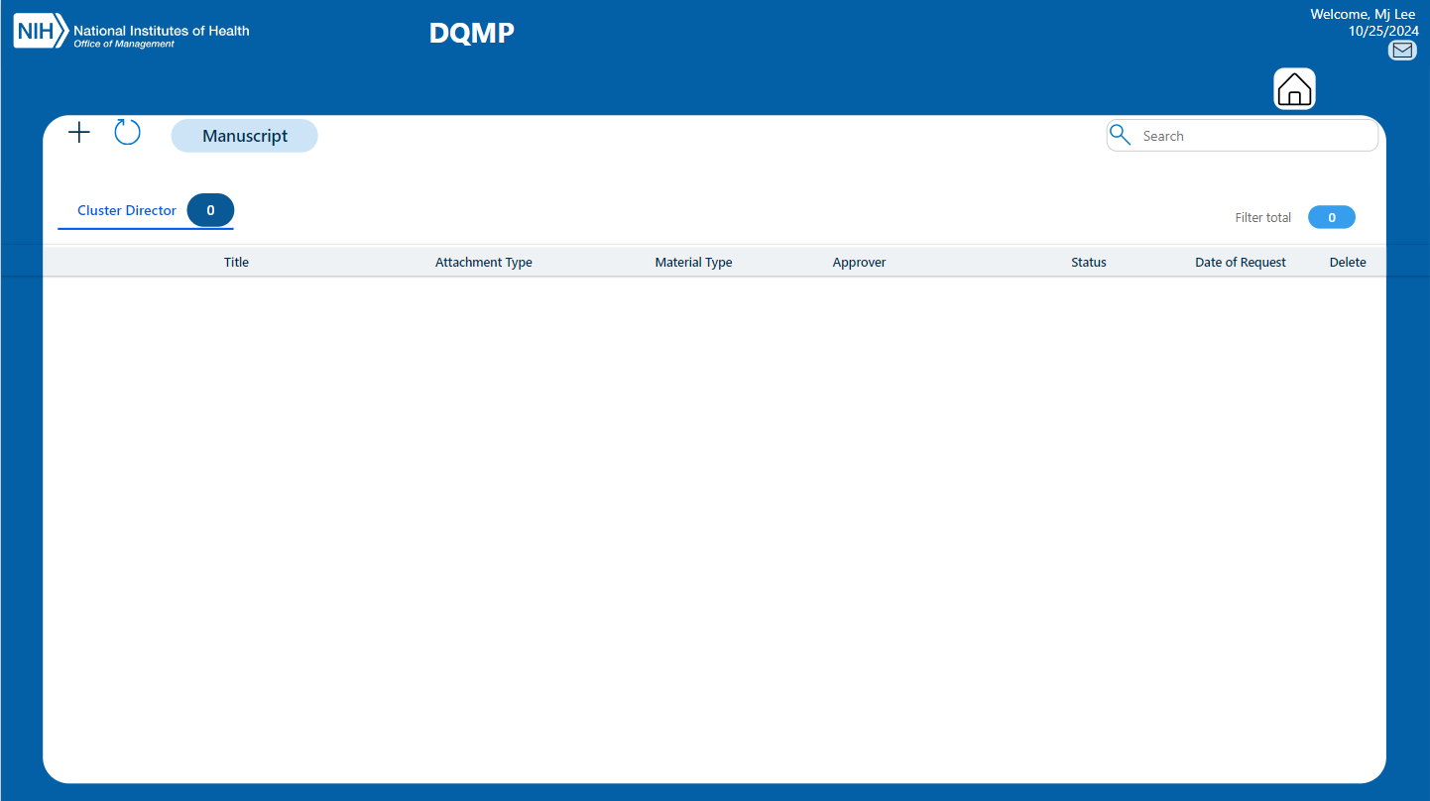
2. Cluster director Approval Dashboard
Click the My Approval icon to view the pending cluster director approval requests.
Click on the request to view the request in the form.
The “Home Icon” navigates back to the dashboard.
View in the form

